Slide 1

Social Identity based Attendance system for counter surveillance
COL707: Introduction to Ethical Issues in Computer Science, Sem I 2023-24
Karissa Berti Khonglam (2020CS50428) | Himadri Rajora (2021CS10117)

Slide 2
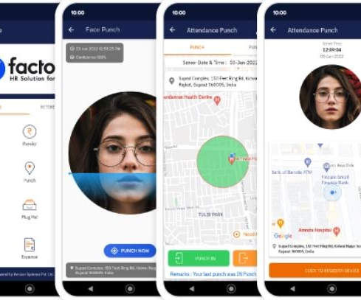
Problem Statement
.Objective: Develop a social identity-based attendance verification system to replace biometrics.
Method: Confirm a student's attendance if vouched by k peers, with a random roll-call of m students to check for false claims.
Deterrence: Penalize students who falsely vouch if the checked student is absent.
Goal: Simulate to find optimal k (peer confirmations) and m (roll-call size) for class size n.

Slide 3
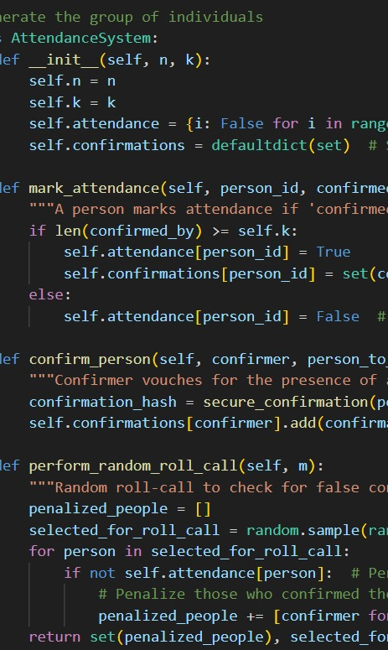
System Setup (Code Overview)
1
Define Parameters: Set n = 100 (class size), k = 5 (confirmations per student), m = 10 (roll-call size), with p_false_attendance = 0.1 and p_collusion = 0.2.
2
Set Up Network and Collusion: Use NetworkX to create a social graph (G) with each student as a node, and mark a subset as colluding who may be absent despite being marked present.
3
Simulate Attendance and Validation: Have k peers confirm each student's attendance, then perform a random roll-call of m students, penalizing those who falsely confirmed absent students.

Slide 4

Metrics Measured
False Positives: Count of absent students wrongly confirmed as present by their peers.
Penalties: Count of penalties assigned to students for falsely vouching for absentees.
Average False Voters Detected, tracks the average number of individuals who falsely vouched for an absent student (colluding) but were still marked as present by others.
False voters caught, tracks the count of colluding students (false voters) who falsely confirmed absences as presence, measuring the effectiveness of detection within the network

Slide 5
Methodology
Code Explanation
Parameters Setup:
n: Class size (number of students).
p_false_attendance: Probability of colluding students being marked as present despite being absent.
p_collusion: Fraction of the class that participates in collusion.
k_values: Range of values for the number of confirmations (k) required for each student.
m_values: Range of values for the number of students (m) checked in random roll-calls.
Graph Initialization:
initialize_graph(): Creates a social network graph of students. Initially, all students are marked as present. A subset of students is selected as colluding, and some of them may be absent based on the p_false_attendance probability.
Confirmations Generation:
generate_confirmations(G, k): For each student, k peers are randomly selected to confirm the student's attendance. This simulates the network of students vouching for each other's presence.
Random Roll-Call and Penalties:
perform_roll_call(G, confirmations, m): A random selection of m students undergoes roll-call verification. For each student found absent, any peer who vouched for them is penalized.
Metrics Collected:
false_positive: Count of instances where an absent student was confirmed as present.
penalties: Count of penalties assigned to students who falsely vouched for an absent student.
Simulation Run and Averaging:
The simulation is run over multiple rounds (simulation_rounds), and the results are averaged to obtain metrics for each combination of k and m.

Slide 6
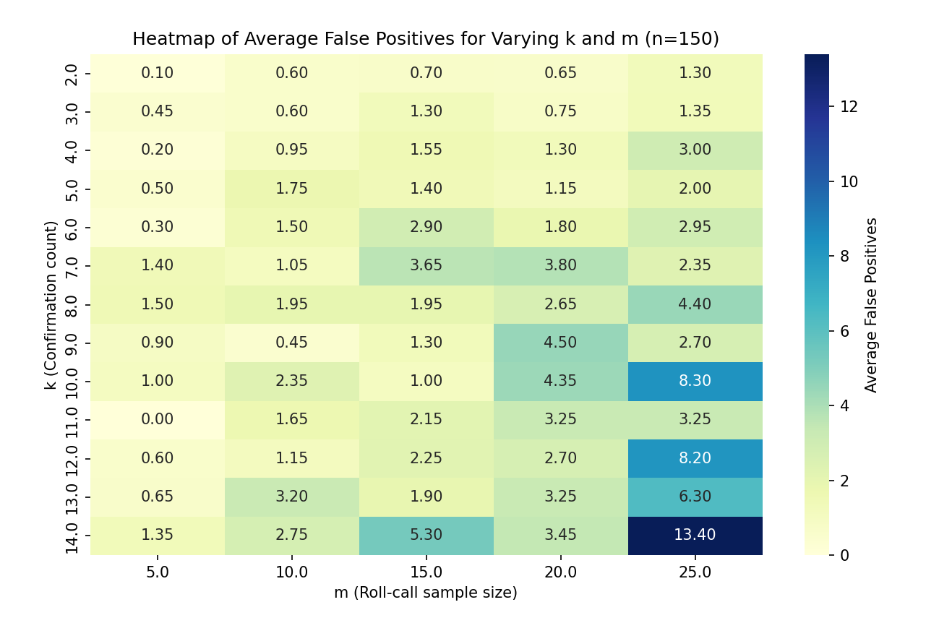
Results
Average False Positives Heatmap:
The heatmap shows the average number of false positives (instances where students are marked present incorrectly) for varying values of k and m.
Observation: Higher values of k generally reduce false positives, indicating that requiring more confirmations improves accuracy. However, there is a balance needed, as extremely high k may add inefficiency.
Average Penalties Heatmap:
The heatmap displays the average penalties issued for false confirmations as k and m vary.
Observation: As m increases (larger roll-call sample size), penalties tend to increase. This suggests that with more students checked, there’s a higher chance of detecting collusion and issuing penalties.
.

Slide 7
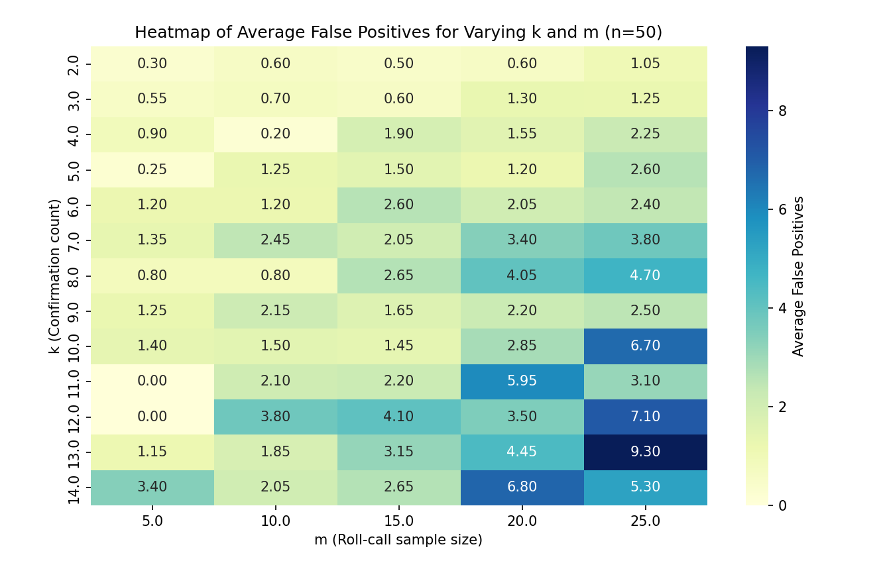

Slide 8
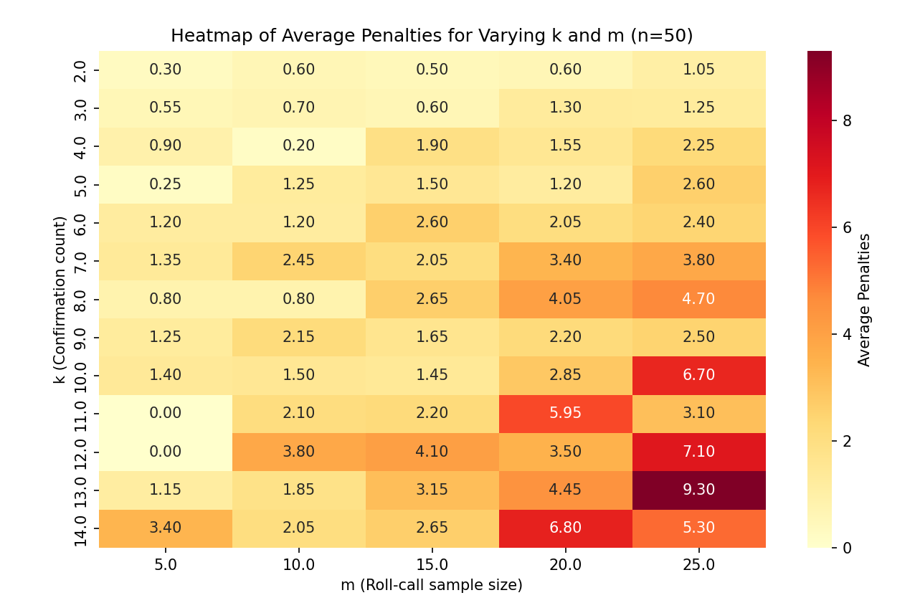

Slide 9
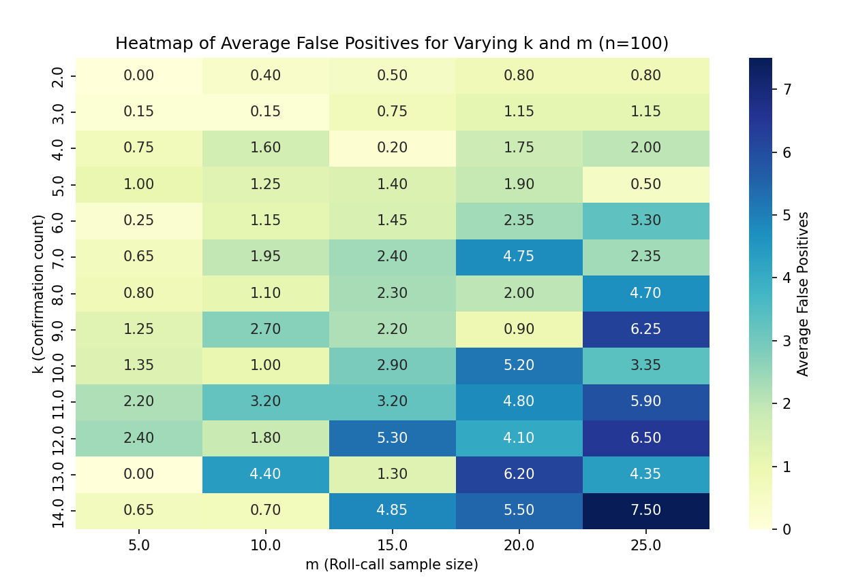

Slide 10
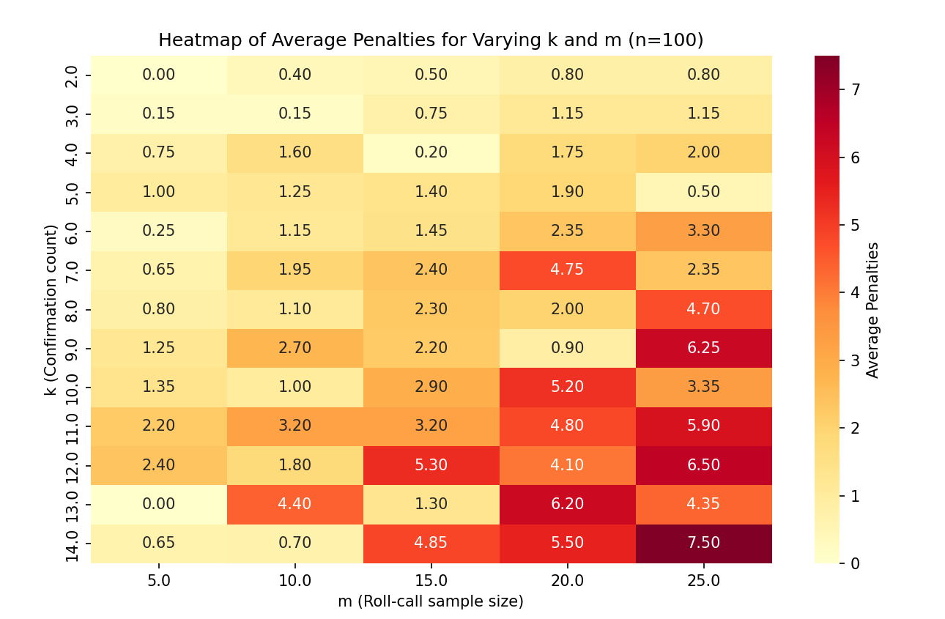

Slide 12
Average false voters detected
New Metric
The new metric, Average False Voters Detected, tracks the average number of individuals who falsely vouched for an absent student (colluding) but were still marked as present by others. This metric reflects how effective the system is at identifying individuals who engage in collusion. By capturing this information, the system can better assess which participants are involved in the collusion network and potentially penalize those who falsely vouch for others.
Code Differences and Methodology
Tracking False Votes:
In the generate_confirmations function, each colluding student's peer confirmations now track the number of false votes they give. If a colluding student confirms attendance for an absent student, their false_votes count increases. This helps to identify students within colluding groups who are falsely marking others as present.
Colluding Group Rotation:
The initialize_colluding_groups function divides colluding students into fixed groups for rotation-based false voting. This rotation simulates real-world scenarios where colluding members take turns marking each other as present to avoid detection.
The rotate_group_attendance function manages this rotation by switching attendance status within each group per round, simulating a structured collusion behavior where different members alternate roles (e.g., who is absent and who is marking others as present).
New Detection Logic in Roll-Call:
In perform_roll_call, when an absent student (detected as falsely marked present) is encountered, the code now checks their peer confirmations. If a confirming peer is a known colluder with non-zero false votes, it counts them as a false voter.
The total number of false voters detected across rounds is averaged, providing insights into how many colluding students are detected per roll-call

Slide 13
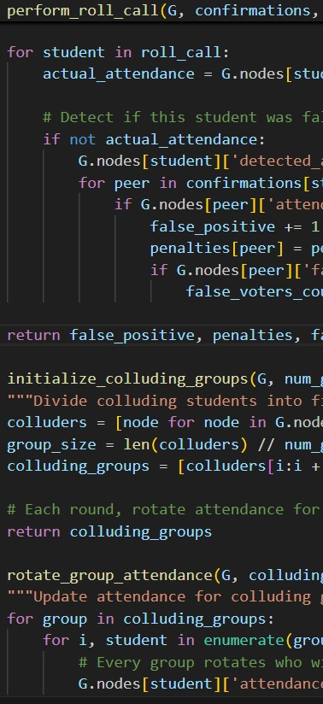
Interpretation of the result
Observations
The results for n = 50, 100, and 150 show how false positives, penalties, and detected false voters vary with changes in k (confirmation count) and m (roll-call size):
False Positives: As k and m increase, false positives generally rise across all n, with larger class sizes (e.g., n = 150) showing higher false positives due to increased detection of colluding members, leading to more peers being wrongly marked present.
Penalties: Higher k and m values lead to more penalties, closely following false positive patterns, showing that penalties are sensitive to false positive occurrences.
False Voters Detected: As k grows, detected false voters increase but at a slower rate than false positives and penalties. Higher m slightly boosts detections, especially in larger classes, as a larger sample reveals more colluders.

Slide 14
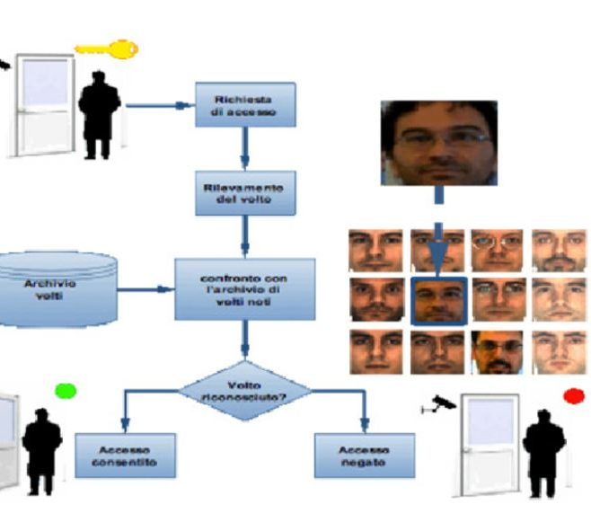
Comparison to previous result
Conclusions
Compared to the previous version:
Increased Complexity in Detection: The introduction of colluding groups with rotating attendance leads to more realistic and complex detection patterns, making it harder to pinpoint exact colluders without the false voter metric.
Insight into Colluding Group Behavior: The false voter metric provides an additional layer of analysis, identifying which individuals are consistently providing false confirmations, thus highlighting central figures in the collusion network.
Higher False Positives and Penalties: The added group rotations and false voting tracking have increased the false positives and penalties, emphasizing the need for an optimized k and m configuration to balance accuracy and penalty fairness.

Slide 15
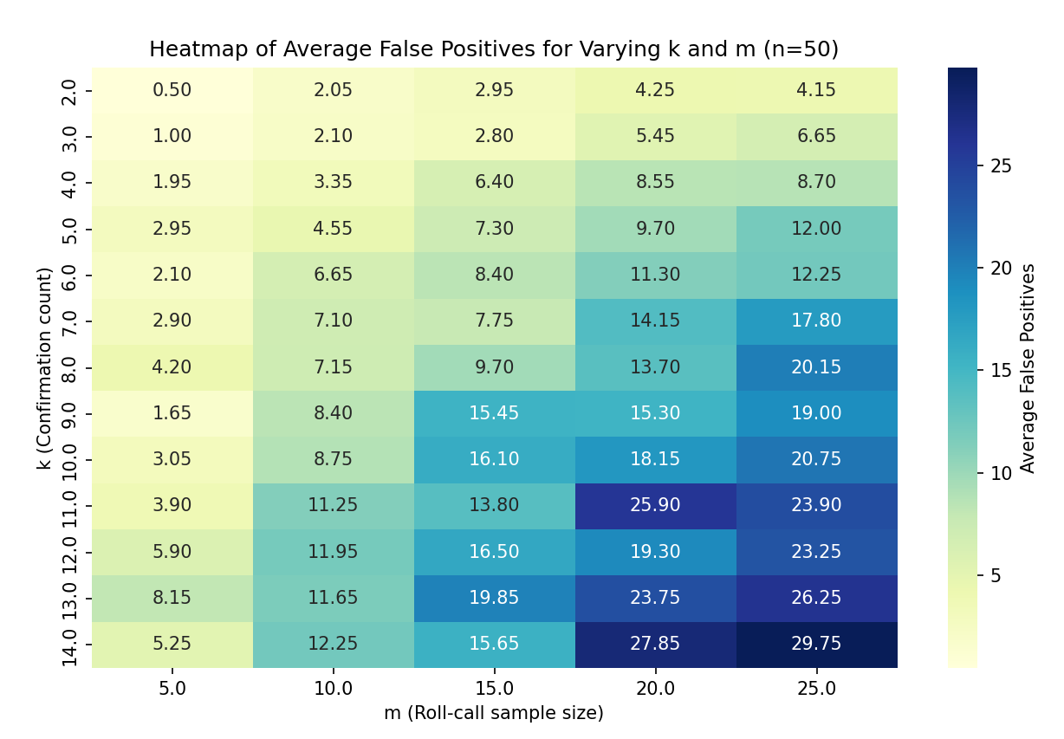
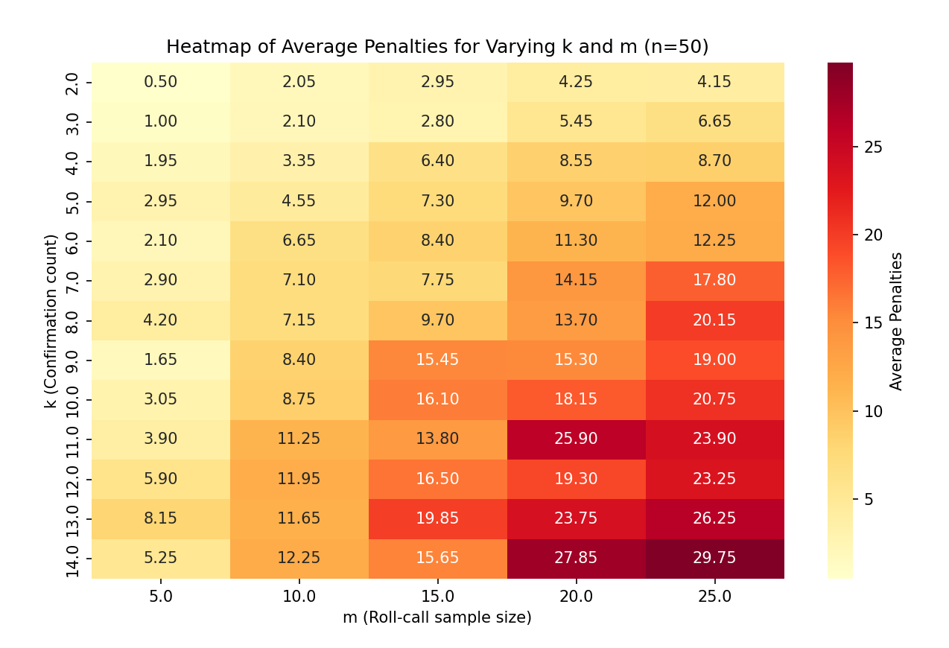
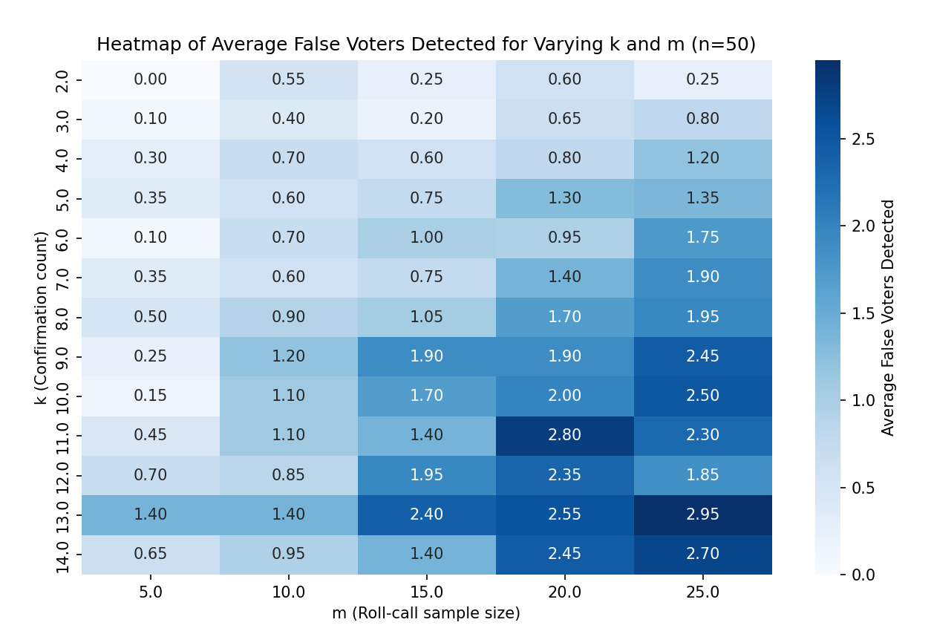
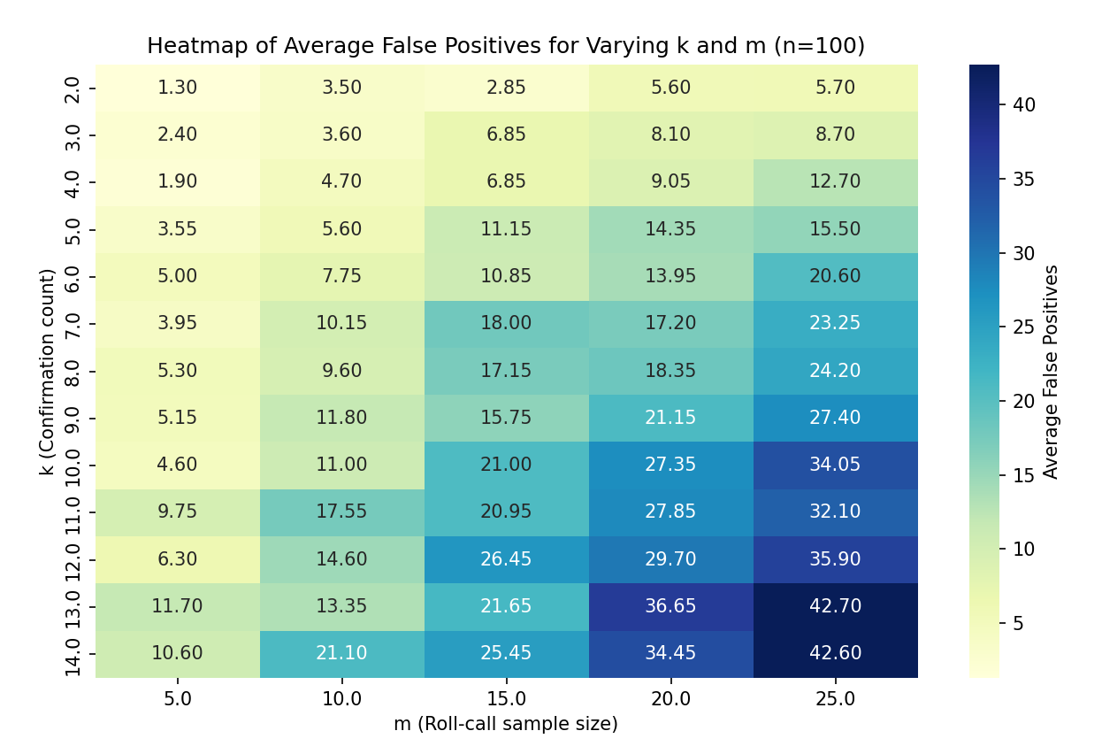

Slide 16
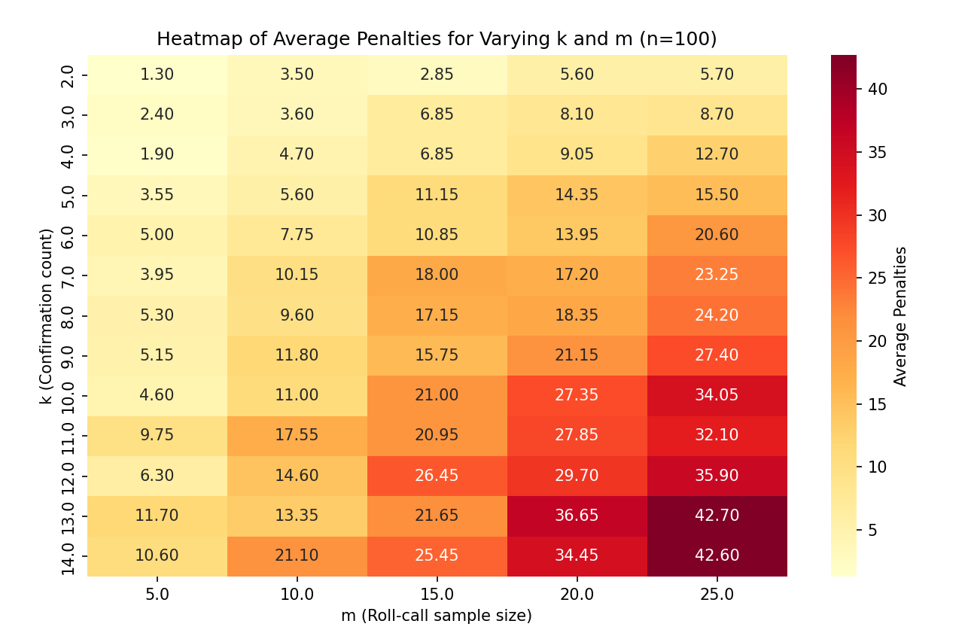
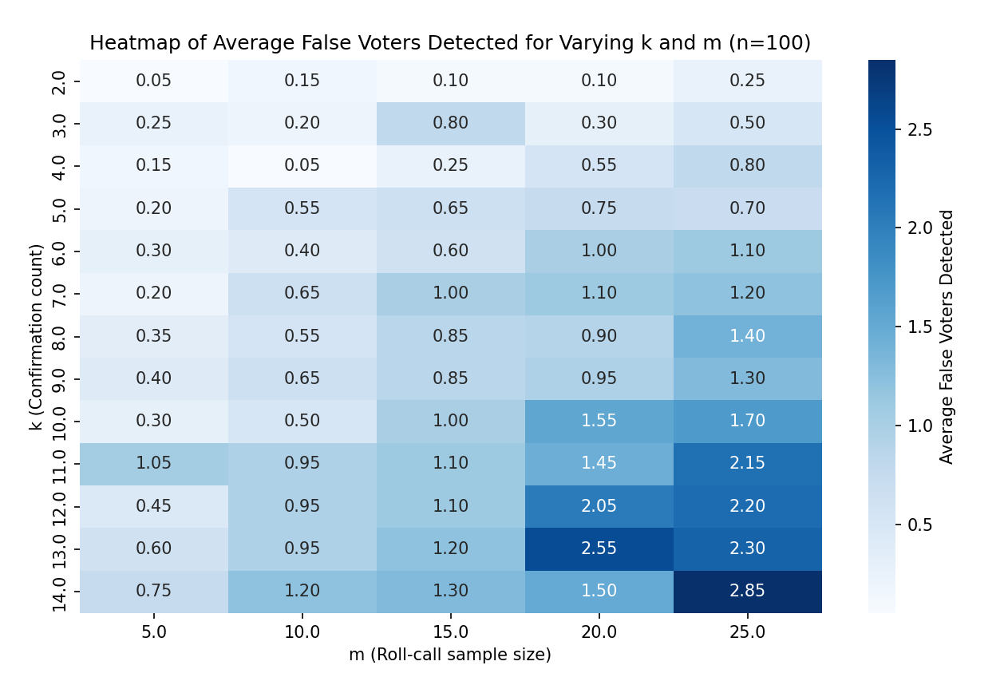
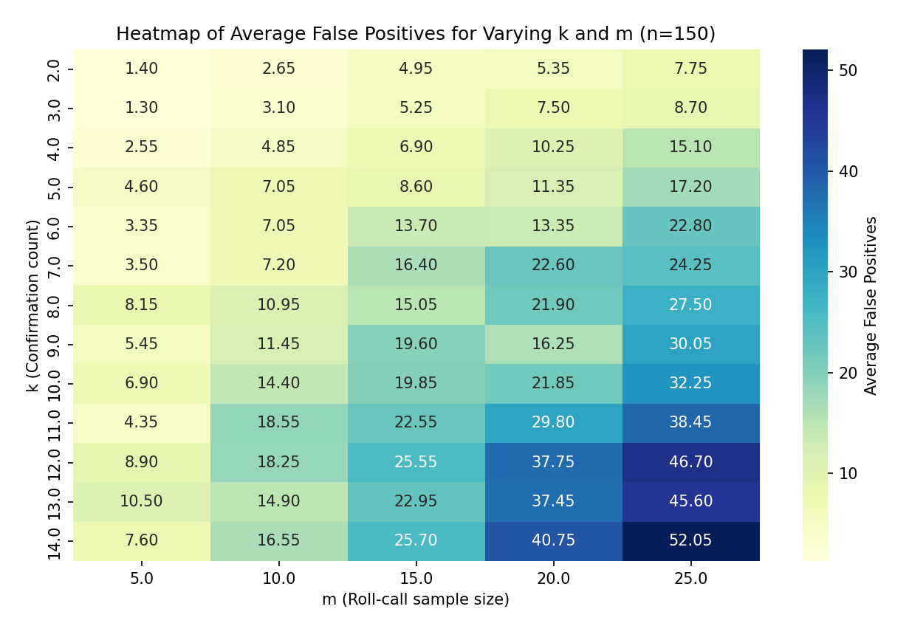
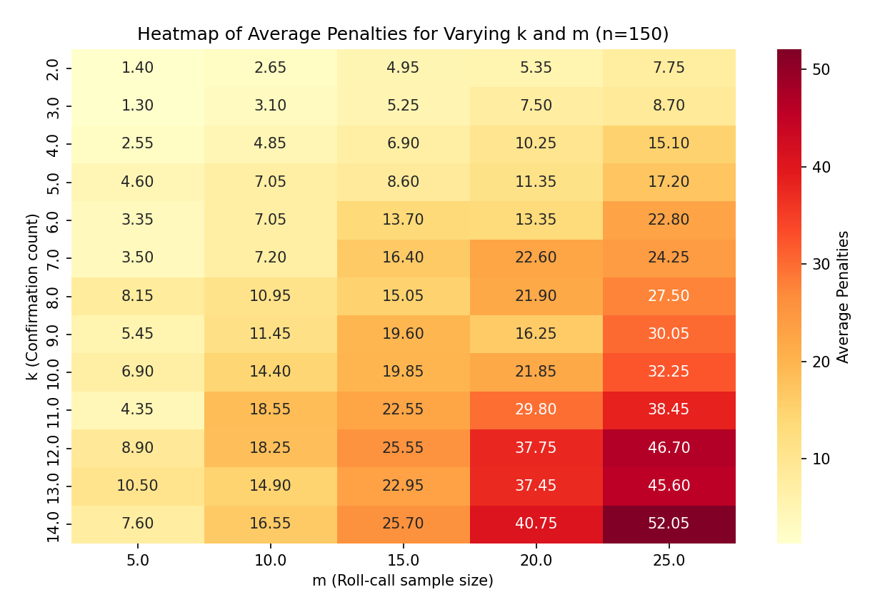

Slide 17
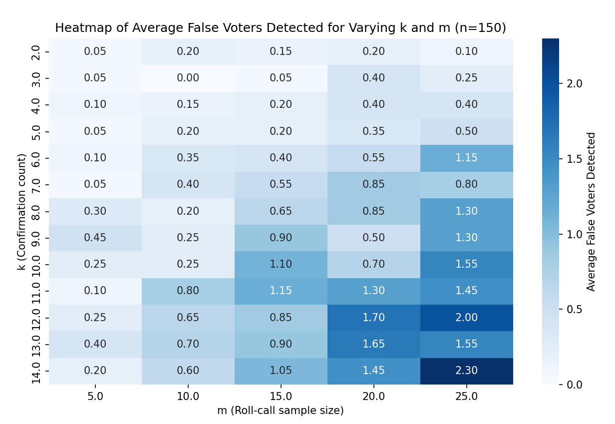

Slide 18
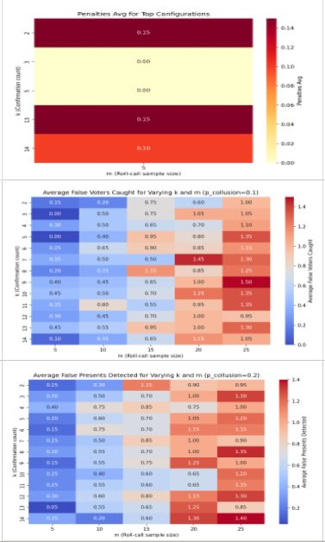
"Average False Voters Caught"
New Metric
The updated code introduces the "Average False Voters Caught" metric, which measures the average number of detected colluding students (false voters). This metric assesses the system's accuracy in identifying attendance manipulation.
Code Modifications and Methodology:
Enhanced Detection for False Voting: Added attributes for false_votes and false_confirmations to track false confirmations given and received. Introduced false_presents_detected to count students falsely marked present and detected in roll call.
Colluding Groups and Rotation: Initialized colluding groups with initialize_colluding_groups, where members take turns marking themselves absent to avoid detection. rotate_group_attendance updates absences dynamically, and generate_group_confirmations manages confirmations among colluders.
Simulation Analysis: find_optimal_parameters tests different values of k, m, and p_collusion to balance minimizing false positives and maximizing caught false voters. A scatter plot visualizes this trade-off for optimal configurations.

Slide 19
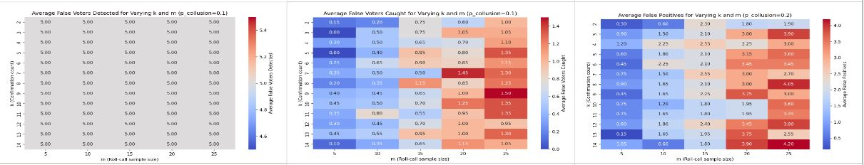
Interpretation of results
Observation
Scatter Plot - Trade-off between False Positives and False Voters Caught
Blue Dots: All configurations tested.
Red Dots: Top configurations with an optimal balance of low false positives and high detection of false voters.
Insight: Points closer to the origin indicate better configurations with fewer false positives and higher detection. Red dots highlight the best trade-off.
Heatmap - Average Penalties for Top Configurations
Overview: Shows average penalties for the best k and m configurations.
Interpretation: Configurations with the lowest penalties are most precise, indicating effective detection with minimal incorrect penalties.

Slide 20

Analysis of Detection Trade-offs and System Sensitivity
Sensitivity to Collusion and Detection Performance
Average False Voters & Presents Detected
Low p_collusion: Few false voters and false presents detected.
High p_collusion: Detection rises, up to 35 false voters, indicating sensitivity but risk of penalizing non-colluders.
Improved System Flexibility
New metrics clarify trade-offs, balancing penalties and detections.
Adjusting k and m by p_collusion allows for targeted system tuning.
Trade-offs in Detection and Penalties
False Positives vs. False Voters Caught
Scatter plot shows balance: red points indicate optimal configurations that maximize false voter detection while minimizing false positives.
Effective trade-off helps reduce penalties for non-colluding students.
Penalties Heatmap (p_collusion Analysis)
Low p_collusion (0.1): Average penalties <1.5, system lenient.
Moderate p_collusion (0.3): Penalties increase, more rigor as k, m rise.
High p_collusion (0.5): Penalties >25, increased detection but more false positives.

Slide 21
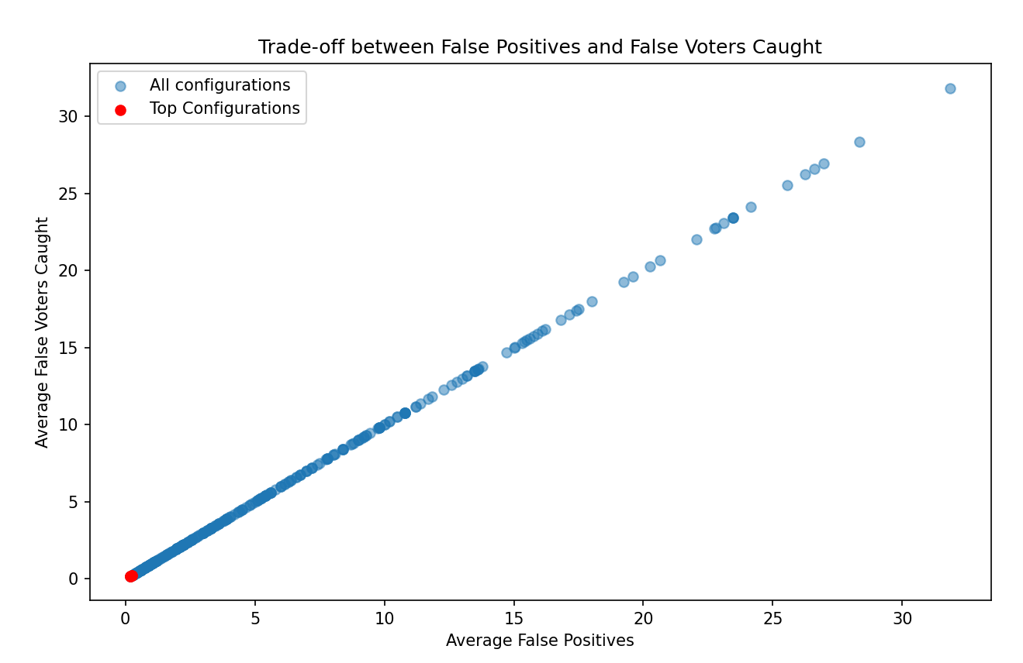
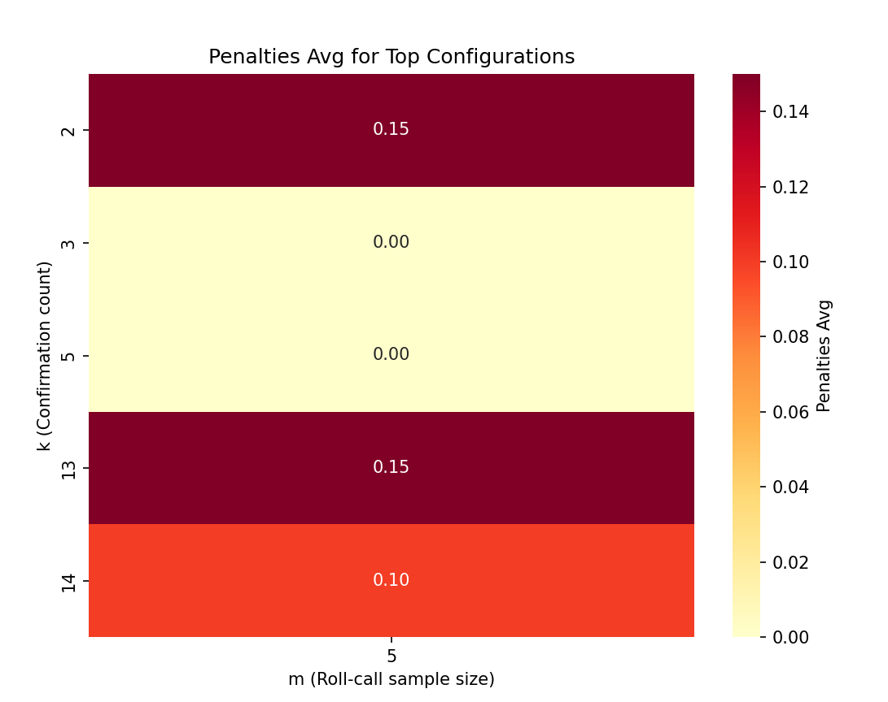
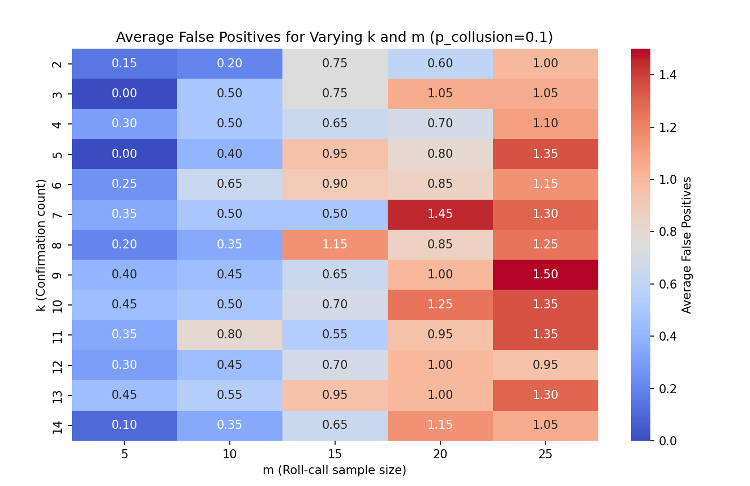
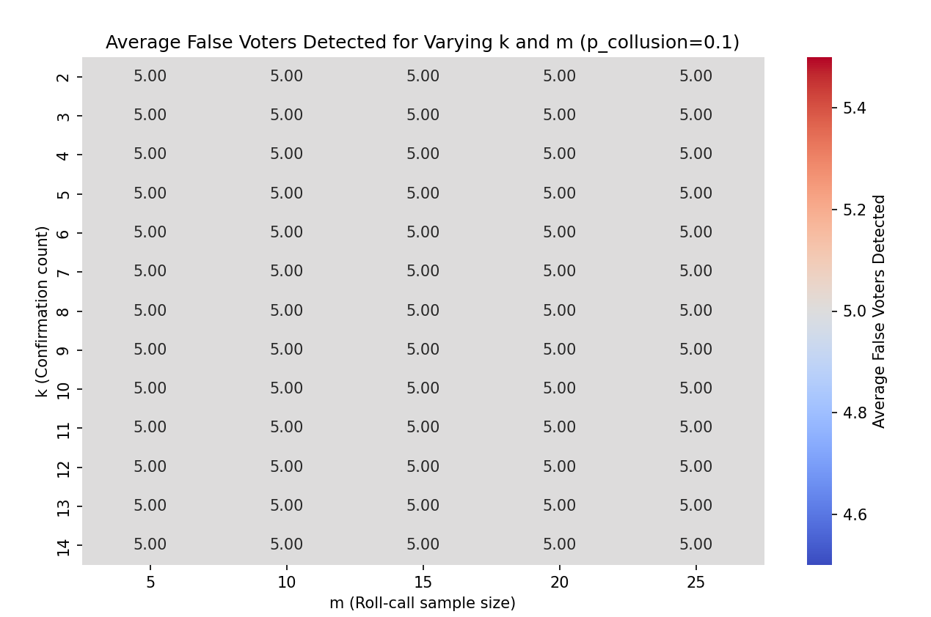
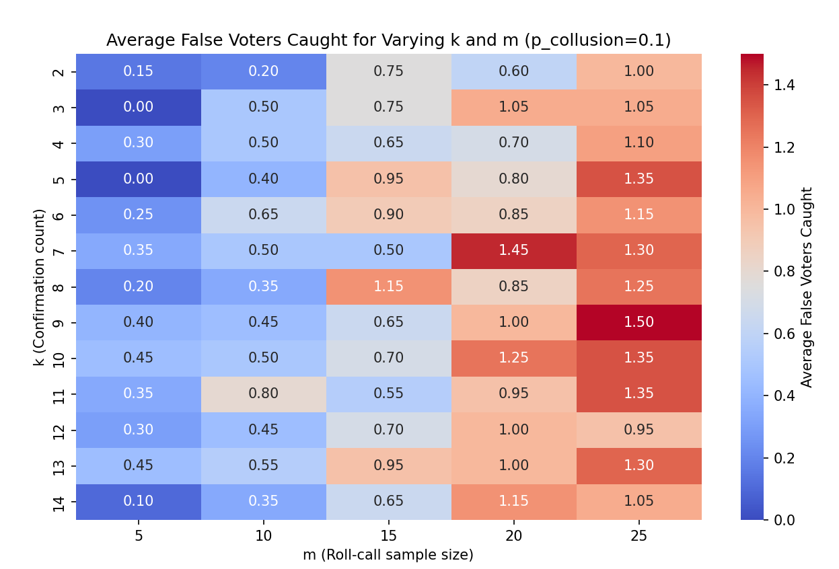
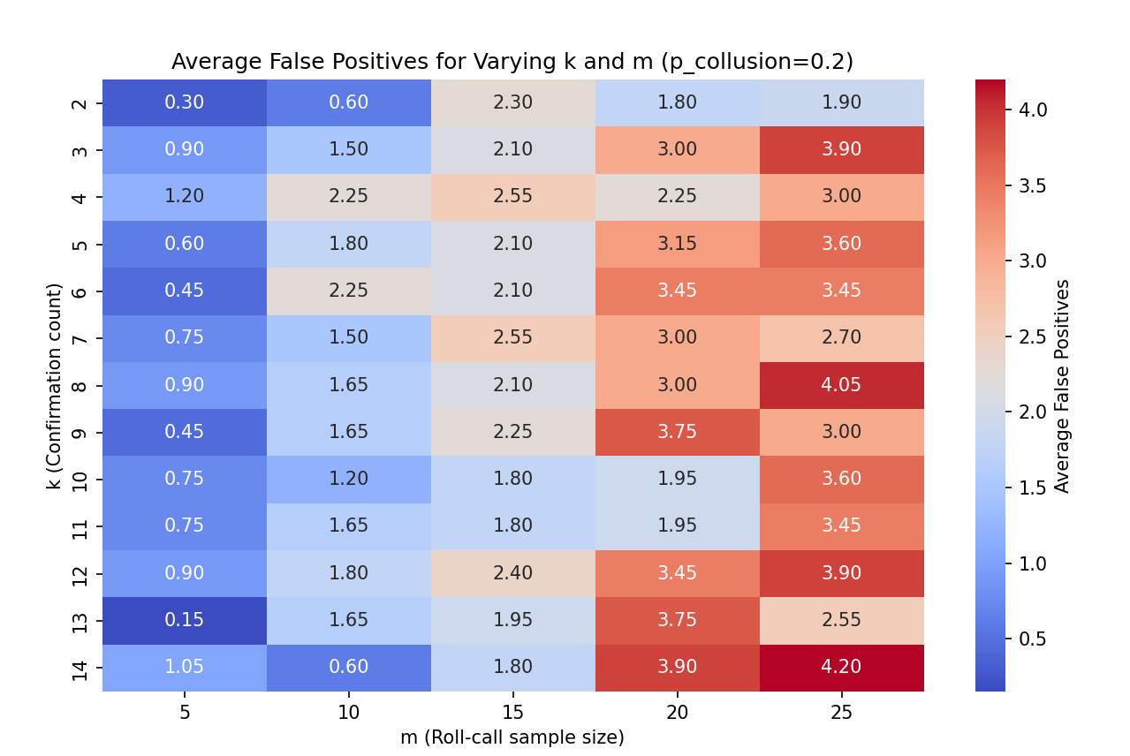
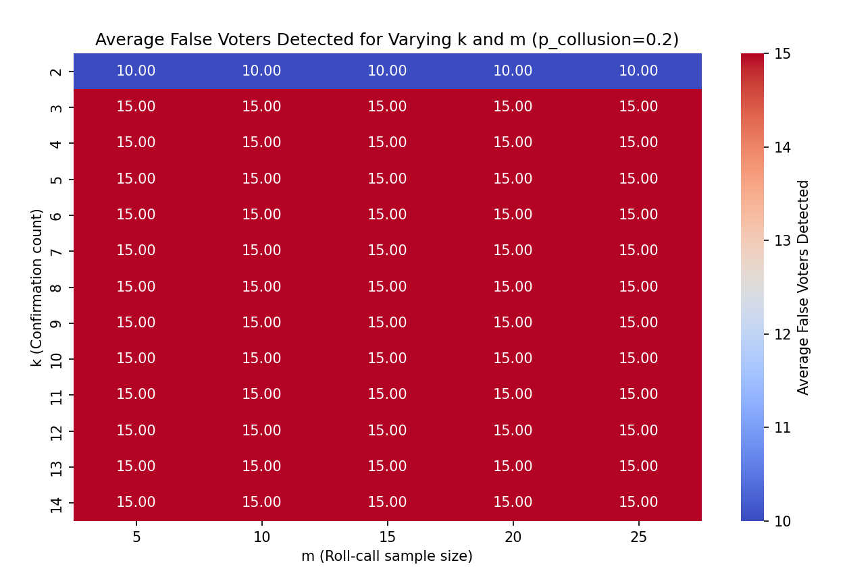
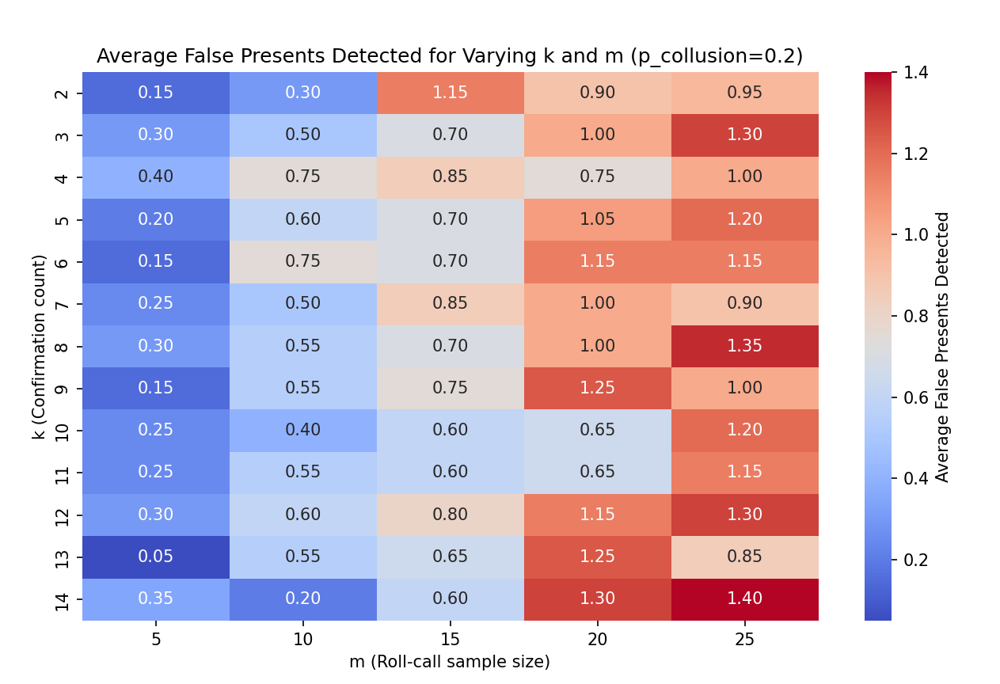
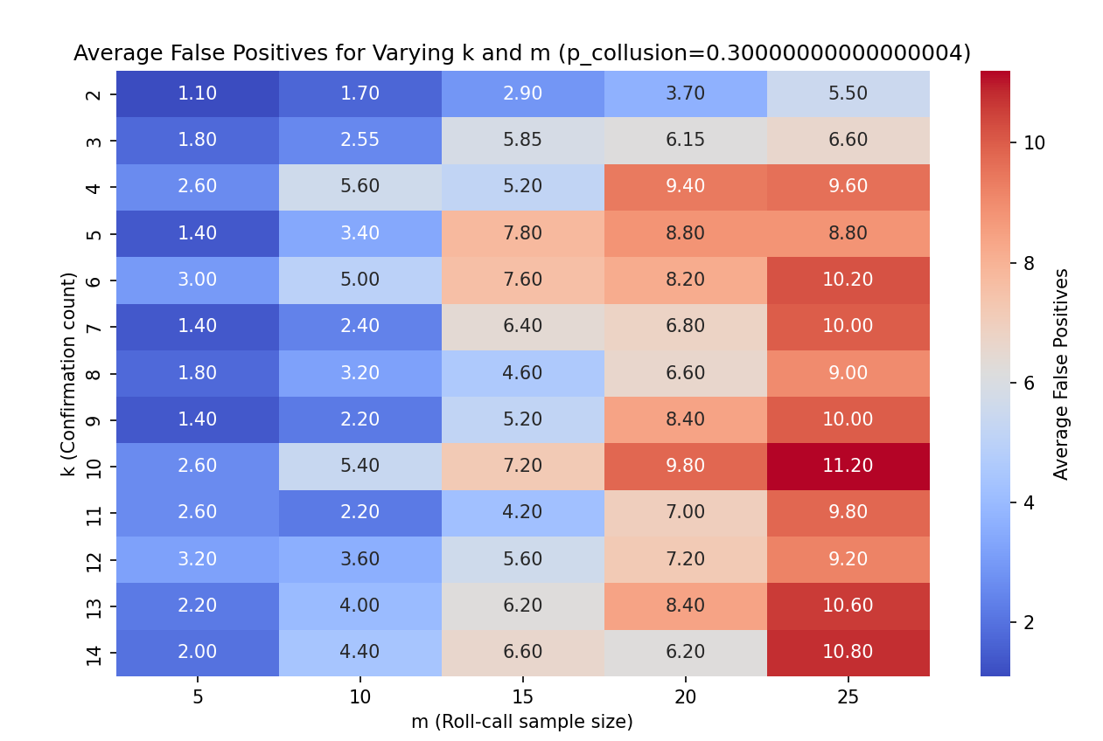

Slide 22
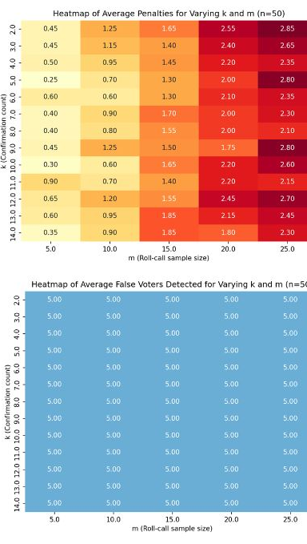
“False voters caught”
New Metric
The new metric in this code iteration, false voters caught, tracks the count of colluding students (false voters) who falsely confirmed absences as presence, measuring the effectiveness of detection within the network.
Code and Methodology Changes
Increased Sampling and Simulation: Simulation rounds increased to 20 for smoother, more stable results.
Group Collusion and Rotation: Added colluding groups with rotating attendance to mimic real-world collusion.
Expanded Parameter Ranges: k now ranges from 2 to 14, and m from 5 to 25, for finer insights.
Multiple Metrics Visualization: Heatmaps now display average false positives, penalties, false voters/presents detected, and the new false voters caught metric.

Slide 23
Detection Trends and Insights Across Different Group Sizes (n)
Insights by Specific n Value
n=50: Lower false positives, penalties, and detected metrics, likely due to a smaller group size with fewer colluders.
n=100: Moderate false positives, penalties, and detection metrics, indicating effective detection without overwhelming the system.
n=150: Substantial increase in false positives and penalties, with higher values for detection metrics, especially with larger m, showing the need for robust sampling and confirmation in larger groups.
General Observations:
False Positives: As n and m increase, false positives also rise, suggesting that larger samples lead to more scrutiny and higher identification of false positives.
Penalties: Higher k and m values lead to more penalties, with m being especially sensitive as larger samples increase infraction detection.
False Voters Detected: Detection rates peak at specific values of n, showing limited but consistent efficiency based on k and m configurations.
False Presents Detected: Increases with n, reflecting higher potential colluders in larger groups, though detection efficiency depends significantly on k and m.
False Voters Caught: Higher k and m improve detection, especially with larger n, showing these values enhance colluding voter identification.

Slide 24
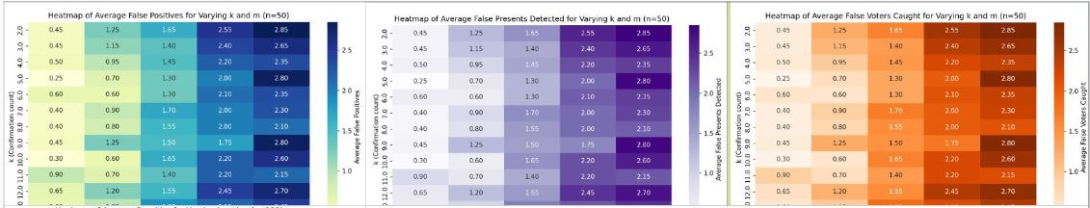
Comparison to Previous Code's Results
Observation
Compared to the previous code:
More Accurate Detection: The additional rounds and averaging lead to smoother, more stable metrics, reducing variance in results. This suggests more accurate and reliable detection metrics.
Higher Sensitivity to Group Collusion: By modeling colluding groups and rotating attendance, the code now simulates more realistic collusion behavior. This enhances the detection of complex collusion strategies.
Broader Parameter Insights: The increased ranges for k and m provide more flexibility and reveal non-linear relationships between these parameters and the detection rates. In the previous iteration, certain configurations may have appeared more effective due to the limited range.
False Voters Caught: This new metric introduces an additional layer of insight, showing how effective different k and m settings are in catching false voters specifically. This refinement allows more targeted tuning of the parameters for scenarios with high collusion risks.

Slide 25
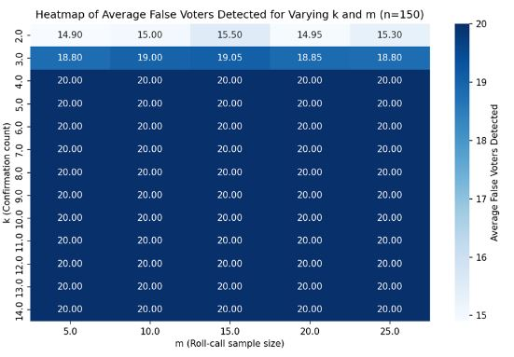
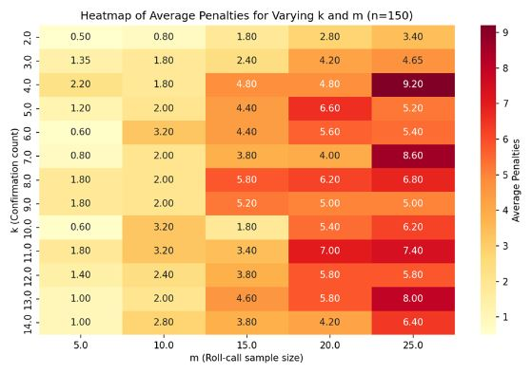
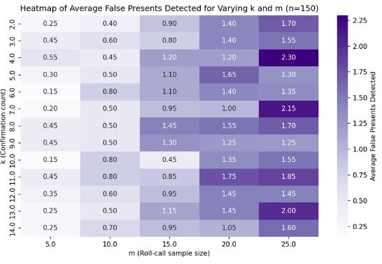
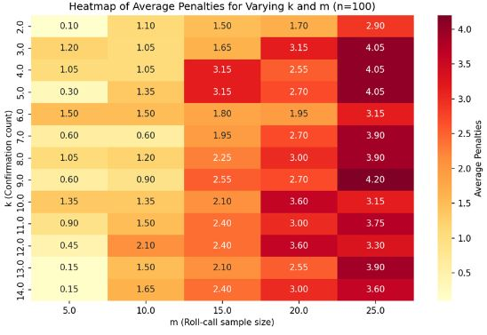
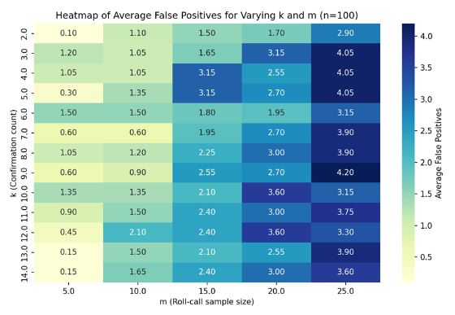
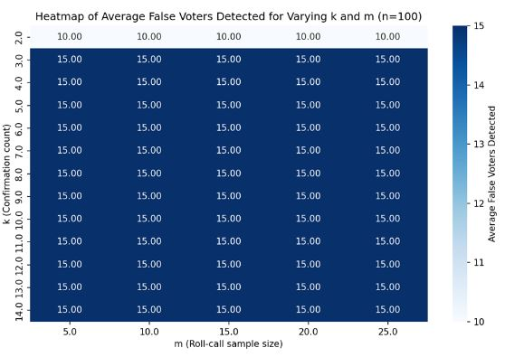
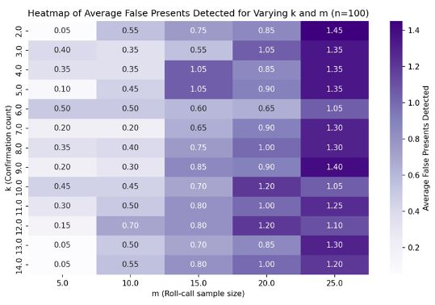
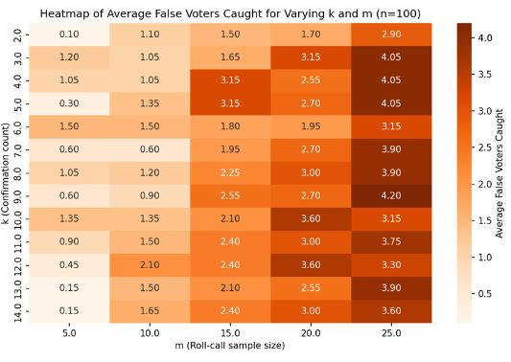
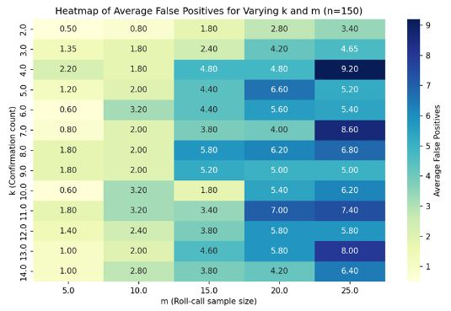

Slide 26
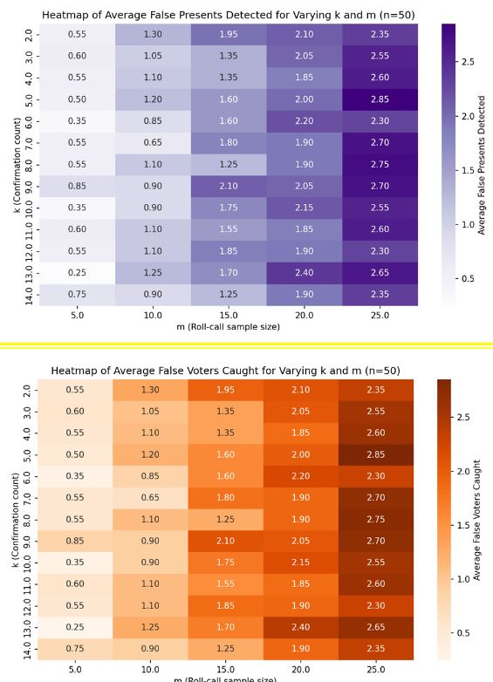
“False Presents Detected”
New Metric
Enhanced Parameter Variability: Testing now spans multiple values of n (50, 100, 150) for different class sizes, with expanded ranges for k (confirmation count) and m (roll-call sample size) to explore parameter space more thoroughly.
New Metrics:
False Voters Caught: Tracks students who falsely confirmed others as present.
False Presents Detected: Counts students falsely marked as present but detected.
Colluding Group Mechanism: Colluding students now rotate attendance within fixed groups, simulating organized real-world collusion.
Detailed Detection Analysis: Counts unique false voters and systematically detects false attendance over multiple rounds.

Slide 27
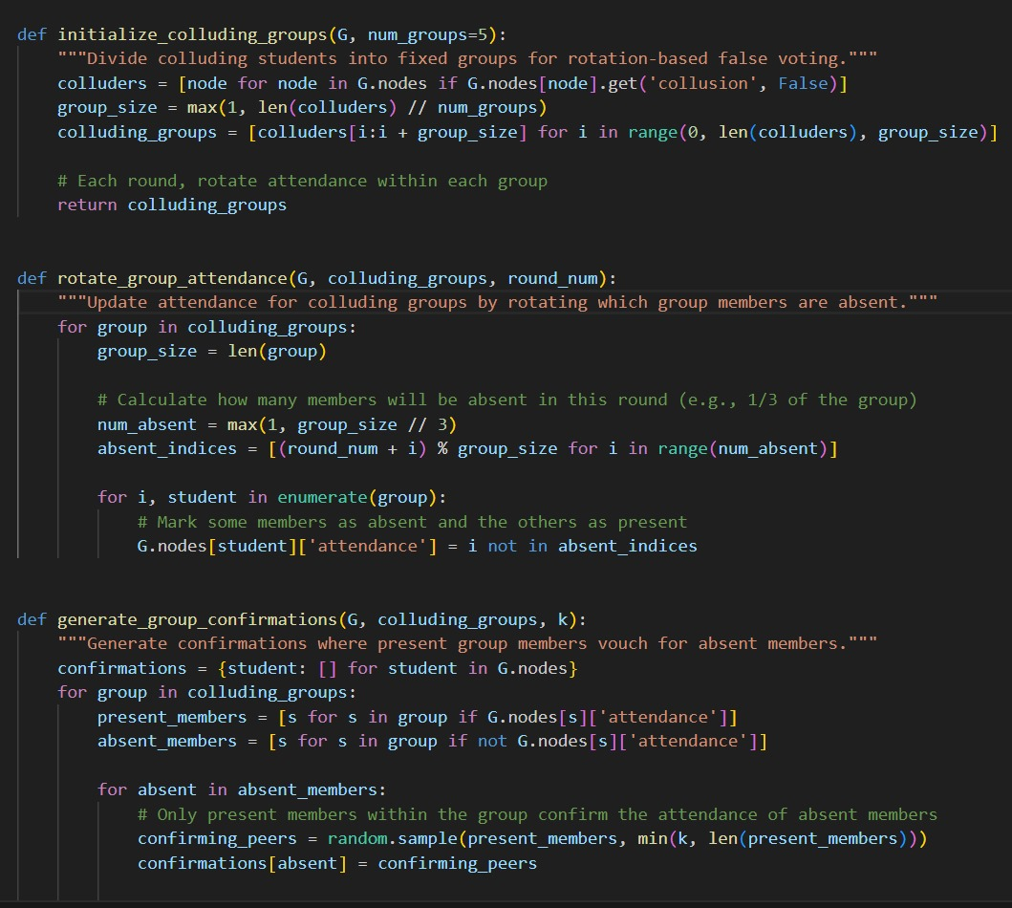
Impact of Class Size and Parameters on Detection Metrics
False Positives: For n=50, false positives are lower, but increase with n, especially at higher k and m values. In n=150, they reach up to 9.0, much higher than the 2.85 max for n=50.
Penalties: Penalties also increase with n, k, and m, indicating stricter roll-call detection. At n=150, penalties reach 9.0, compared to a max of 2.75 for n=50.
False Voters Detected: With n=50 and n=100, detected false voters stay around 5 and 15, respectively, but rise to 20 at n=150 with high k and m, showing improved detection in larger classes.
False Presents Detected: False presents detected rise with k and m across class sizes, reaching 2.25 for n=150 and around 2.35 for n=50, suggesting detection is more influenced by catching likelihood than class size.
False Voters Caught: Higher k and m values lead to more false voters caught, peaking at 9 for n=150 versus 2.85 for n=50.

Slide 28
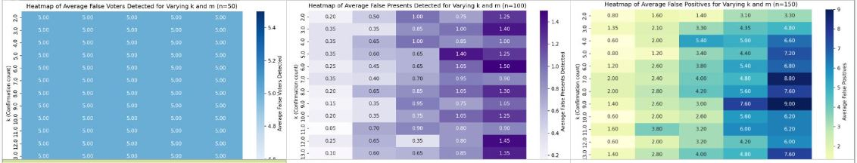
Interpretation and Recommendations
Observation
Effectiveness of Higher k and m: Increasing k (confirmation count) and m (roll-call sample size) improves detection metrics but also raises false positives and penalties. A higher k strengthens collusion resistance but risks over-penalization in larger classes like n=150, requiring a balance.
Scalability with Class Size: For smaller classes (n=50), lower k and m values provide effective detection with minimal penalties. In larger classes (n=150), stricter values for k and m improve detection but increase false positives and penalties.
Optimal Parameter Selection: For n=50, k values of 2-7 and m values of 5-10 are effective with fewer false positives. For n=150, moderate to high values (m 15-20, k 10-12) maintain detection effectiveness, keeping penalties manageable.

Slide 29
“p_collusion Parameter”
New Metric
p_collusion Parameter in initialize_graph: In the initialize_graph function, p_collusion controls the fraction of colluding students, allowing simulation of different collusion levels (e.g., 0.1, 0.2, 0.3). This helps analyze how varying collusion affects detection metrics. In the latest code, p_collusion is defined globally and adjusted in simulation rounds.
find_optimal_parameters Function: This function simulates various k, m, and p_collusion values, recording average results for each setup. It calculates metrics like false_positives_avg, penalties_avg, false_voters_avg, false_presents_detected_avg, and false_voters_caught_avg, identifying optimal configurations under different collusion levels.

Slide 31
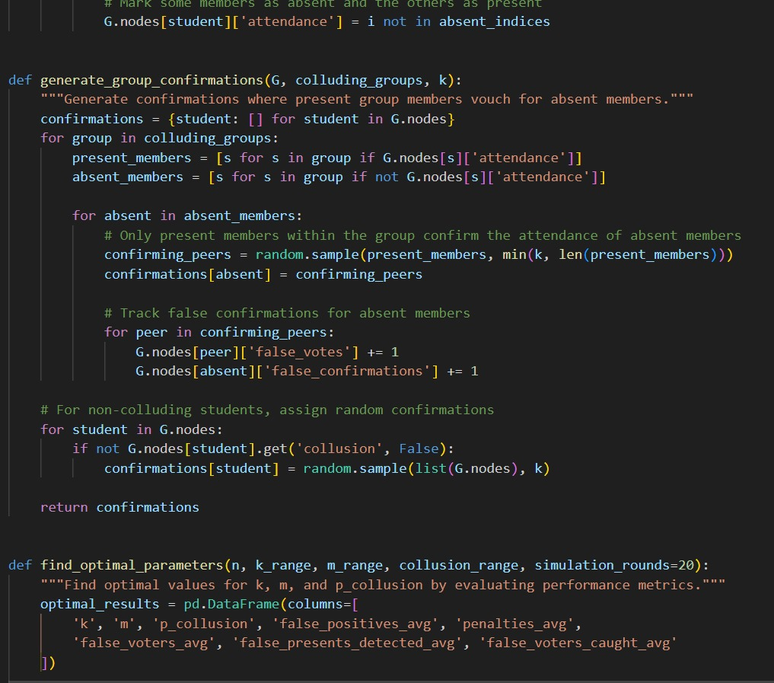
Impact of p_collusion on Detection Metrics
General Observations Across p_collusion Levels
False Positives: Higher p_collusion increases false positives due to more false confirmations, with averages staying below 3.0 at 0.1 and rising above 4.0–5.0 at 0.2 and 0.3.
Penalties: Similar to false positives, penalties increase with higher p_collusion, averaging below 3.0 at 0.1 and rising with collusion levels.
False Voters Detected: Detection remains stable across p_collusion levels, suggesting effective sampling in identifying a consistent number of false voters.
False Presents Detected: Slightly rises with higher p_collusion but stays below 2.0 on average, indicating effective detection of falsely marked presents.
False Voters Caught: Increases with p_collusion but less significantly, staying around 2.0 at 0.1 and reaching 3.0–4.0 at 0.3.

Slide 32
Interpretation of results
Observation
Impact of p_collusion:
The increase in false positives and penalties with higher p_collusion values indicates that as more students engage in collusion, the system struggles more to accurately identify absences. This suggests that increased monitoring (higher k and m values) may be necessary in high-collusion scenarios to reduce these metrics.
Optimal Values of k and m:
Lower k values and higher m values generally reduce false positives and penalties, as higher roll-call sample sizes improve the chances of catching collusion. However, with increased p_collusion, both k and m may need to be adjusted upwards to keep false positives and penalties manageable.
These heatmaps indicate that the optimal combination of k and m will depend on the acceptable threshold for false positives and penalties in a real-world scenario.
Scalability:
By adjusting p_collusion, this model demonstrates its ability to scale with different levels of student collusion. As p_collusion rises, the system's ability to detect falsifications diminishes, showing the need for adaptive confirmation thresholds based on the estimated level of collusion.

Slide 33
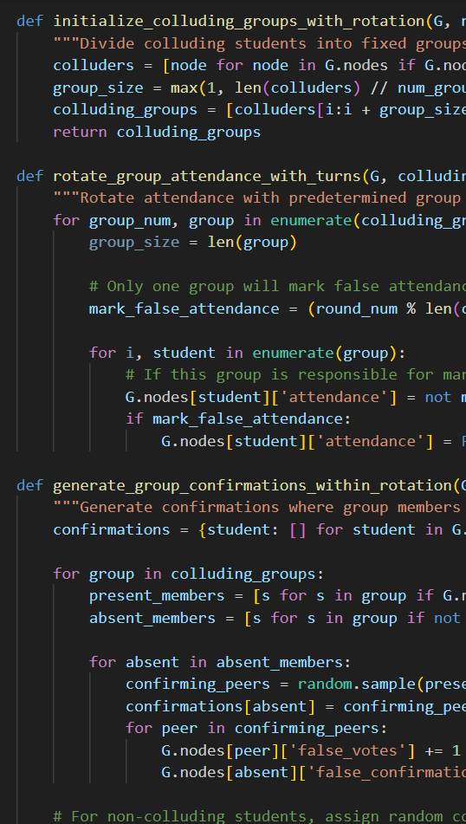
New colluding group behaviour
Modifications
New Colluding Group Behavior:
Two new functions, initialize_colluding_groups_with_rotation and rotate_group_attendance_with_turns, were added to define and implement a rotation-based collusion strategy.
This modified approach divides colluding students into groups, where each group takes turns in marking false attendance. Only one group at a time engages in false attendance during each simulation round.
Turn-Based False Attendance Rotation:
In rotate_group_attendance_with_turns, only the group designated for that round will have its members falsely mark themselves as absent.
This rotation-based strategy simulates a more sophisticated collusion tactic, where colluding students coordinate their attendance status to avoid detection.
Group-Based Confirmations:
The function generate_group_confirmations_within_rotation was modified to have present members within a colluding group confirm the attendance of absent members. This creates a system where colluding members vouch for each other, thus potentially increasing the challenge of detecting false presents.
Notes:
. Dynamic Collusion Networks
Evolving Collusion Groups: Rather than static colluding groups, introduce dynamic collusion networks where groups can merge or split over time, simulating real-life scenarios where social groups change.
Hierarchical Collusion: Introduce a hierarchy in collusion where some members influence others to participate. Some individuals could act as “leaders” with more control over attendance decisions, affecting the network’s structure.

Slide 34
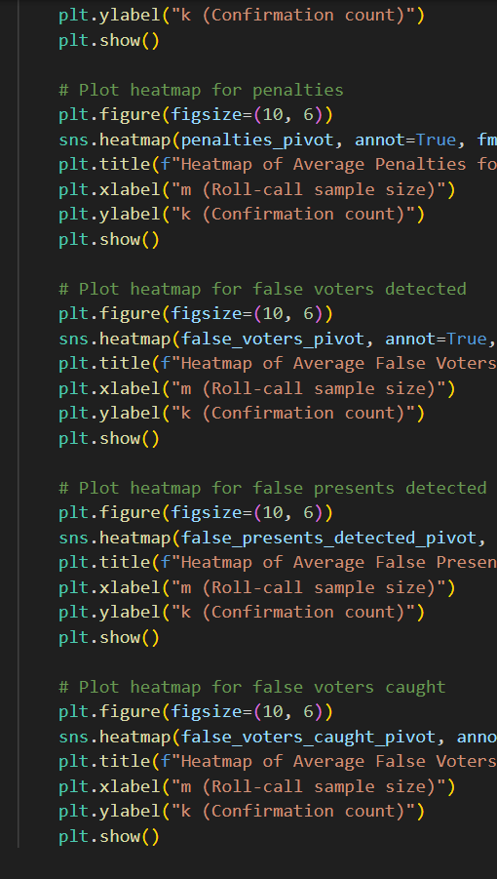
Impact on results
Modifications
This new collusion behavior impacts only the metric for average false presents detected. Here’s why and how this change affects this specific metric:
Increased Difficulty in Detecting False Presents:
By organizing collusion in groups with rotational attendance falsification, this system creates a scenario where only a subset of colluders are marked as absent in each round. This reduces the likelihood that all colluding students are identified simultaneously, making it harder to detect absences.
The group-based confirmation within each colluding group ensures that the absent members receive consistent confirmations from present members, further obscuring the true attendance status.
Higher Average False Presents Detected:
With the rotational strategy, the system is less likely to detect all absentees accurately in a single round. Therefore, the average false presents detected metric rises because more colluders succeed in falsely marking their attendance over multiple rounds.
The increase in false presents detected is likely due to the coordinated nature of the confirmation system within colluding groups, which lowers the probability that an absent student will be flagged as falsely present in each round.
Isolated Impact on False Presents:
Other metrics like false positives, penalties, false voters detected, and false voters caught remain largely unaffected. This is because these metrics are more influenced by the structure of the confirmation network and the roll-call sampling process. The rotational attendance behavior primarily impacts the identification of false presents due to the coordinated confirmations within colluding groups.

Slide 35
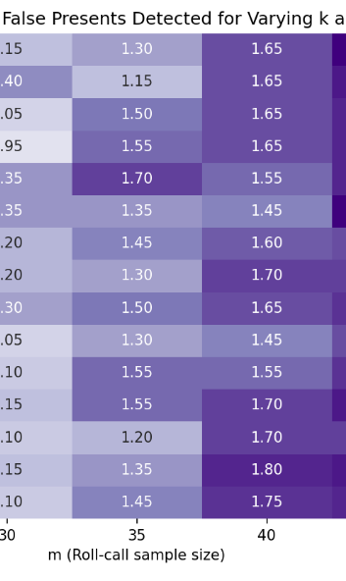
SUMMARY
The modified code introduces a more sophisticated collusion strategy with group-based rotational attendance falsification. This behavior results in an increase in average false presents detected due to the organized confirmations within each colluding group. By taking turns to mark false attendance, colluders create a scenario where fewer absentees are detected, leading to a higher rate of undetected false presents on average. This strategy successfully obscures individual attendance statuses, complicating the detection process and specifically affecting the accuracy of the false presents detected metric.

Slide 36
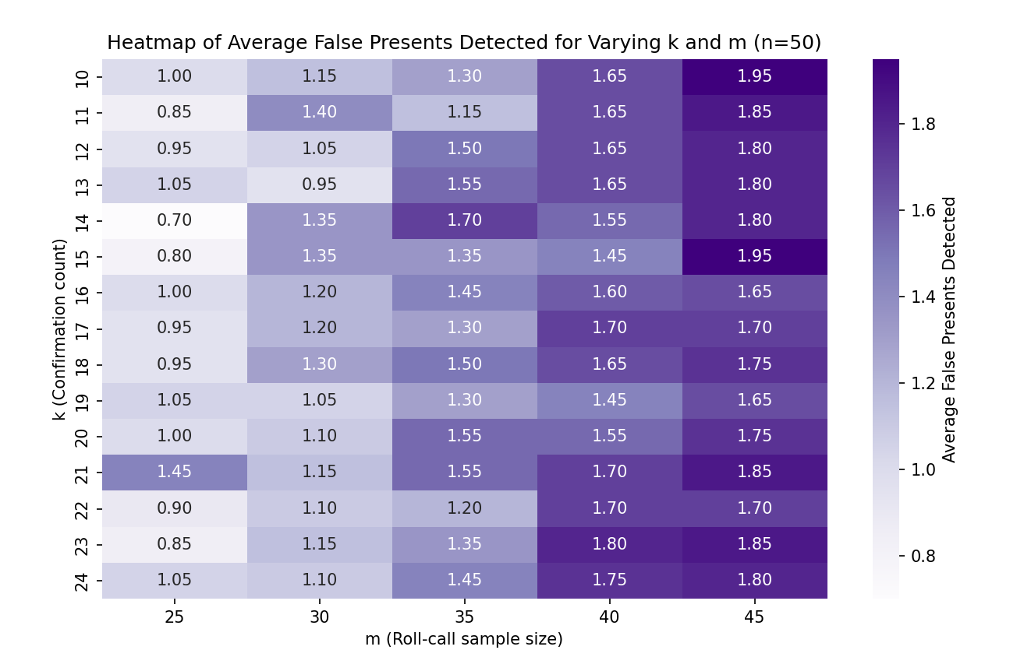

Slide 37
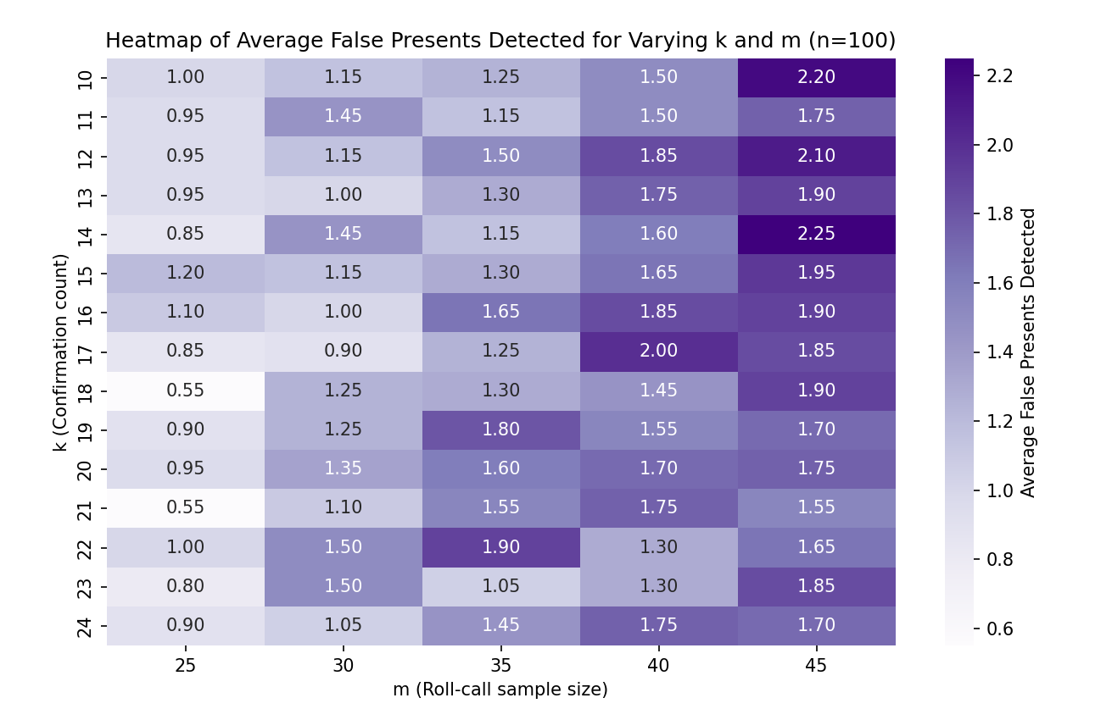

Slide 38
Community structure
Modifications
Key Additions
Community Detection:
The initialize_graph_with_communities function now builds the graph using NetworkX's erdos_renyi_graph model and identifies communities within the graph using the Greedy Modularity Communities algorithm.
Each node is assigned a community attribute, representing the community to which it belongs.
Centrality Calculation:
Degree Centrality is calculated for each node using NetworkX’s degree_centrality function.
The centrality value of each node, representing the node’s importance or influence within the network, is stored in the node attribute centrality.

Slide 39
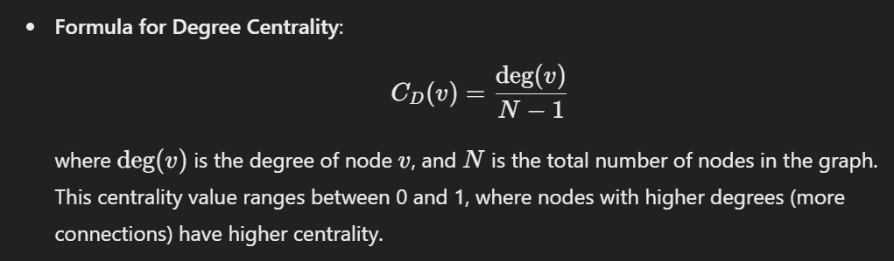
Centrality measures
Modifications
Community-Based Confirmation:
The generate_community_based_confirmations function selects confirmation peers for each student based on their community and centrality values.
Confirmers are selected preferentially from within the same community. If there aren’t enough confirmers in the community, the selection expands to the entire network, with higher centrality nodes being more likely to be chosen.
Weighted Sampling by Centrality: This function uses random.choices with weights based on centrality scores, favoring nodes with higher influence.

Slide 40
Impact on heatmap simulation results
Modifications
Average False Positives:
By selecting confirmers based on community membership and centrality, colluding students are more likely to receive confirmations from their community members, especially those with high centrality (highly connected individuals).
This increases the chances of false positives, as students who are not present might still receive confirmation from influential peers in their community.
Penalties:
The penalties may vary depending on the community structure. If colluding students are within tightly-knit communities, the system might detect fewer penalties because colluding groups can vouch for one another, thus reducing the likelihood of penalties.
However, if some high-centrality nodes (influencers) are caught, penalties could spike as they may confirm multiple students.
False Voters Detected:
False voters detected might increase if the roll call targets high-centrality nodes who collude, as their role in confirming others would expose them to detection.
Conversely, if the network is structured in a way that keeps colluding nodes isolated in a single community, the detection might be minimized, depending on how the roll-call sampling intersects with the communities.
False Presents Detected:
With community-based confirmations, false presents might decrease, as absent students are more likely to be confirmed by others in their own community, reducing the chance of being caught.
However, if the roll-call sampling includes nodes outside the colluding community, the detection of false presents may increase since these nodes have no incentive to confirm absentees.
False Voters Caught:
High-centrality nodes in colluding communities play a crucial role in confirming others. If one such central node is caught, multiple false voters might be exposed, especially if these nodes are part of the roll call.
The impact on this metric will depend on whether influential colluders are sampled during roll calls.

Slide 41

SUMMARY
1
Higher Average False Positives: Due to the influence of community-based confirmations, colluding students are more likely to receive confirmations, resulting in higher false positives. Variable Penalties: Penalties may fluctuate based on community structure and centrality of colluding nodes.
2
False Voters Detected: Likely to be higher if influential nodes are sampled during roll calls, especially if they are confirming multiple absentees.Reduced False Presents Detected: Community and centrality-based confirmations can mask absenteeism within colluding communities, thus reducing false presents detected.
3
False Voters Caught: Affected based on whether influential colluding nodes are part of the sampled roll call.

Slide 42


Slide 43


Slide 44


Slide 45


Slide 46


Slide 47


Slide 48


Slide 49


Slide 50


Slide 51
Dynamic collusion networks
Modifications
Evolving Collusion Groups:
Dynamic Group Evolution: The function evolve_colluding_groups now allows colluding groups to dynamically merge or split at each round. This change simulates a realistic scenario where social groups are fluid and can change over time.
A probability (group_change_probability) controls whether a group will split or merge. If a group splits, it divides into two smaller groups. If it merges, it combines with another random group to form a larger one.
Hierarchical Collusion:
Leadership Role: Each initial colluding group is assigned a leader. Leaders influence the group’s attendance, increasing the likelihood that group members follow the leader's attendance pattern.
Influence on Absence: In the rotate_group_attendance function, if the leader is absent, there is a higher absent ratio for the rest of the group (e.g., 50% vs. 30% default). This hierarchical influence reflects the real-world tendency for certain individuals to have more sway in social dynamics.

Slide 52
Impact on results
Modifications
Average False Positives:
Higher False Positives in Some Cases: With leaders influencing group attendance, groups may have more coordinated false attendance, especially when leaders are absent. This coordination can increase false positives since group members are more likely to confirm absentees.
Dynamic Group Sizes: As groups merge or split, the network structure changes, sometimes creating larger groups that can support each other’s absenteeism, leading to higher false positives in those cases.
Penalties:
Variable Penalties Based on Group Size and Leader Influence: Penalties can vary more significantly due to the dynamic nature of colluding groups. Larger groups, formed by merging, could lead to higher penalties if detected, as more members would be marked for falsely confirming absentees.
Leader Influence: If leaders are detected as colluders, they can attract penalties to a greater number of members due to their influence. This may increase penalties in situations where influential leaders are part of the roll call.
False Voters Detected:
Fluctuations in Detection Rates: Due to the evolving nature of groups, the detection rate of false voters could fluctuate. Larger groups or groups with active leaders might increase the likelihood of detection, especially if sampled during roll calls.
Concentration in Leader-Influenced Groups: Groups with a strong leader presence may show higher detection rates as these groups might have more coordinated attendance patterns, making them more detectable in certain cases.
False Presents Detected:
Reduced Detection in Tight-Knit or Larger Groups: Larger or more cohesive groups (after merging) can better mask absenteeism due to coordinated confirmations, leading to fewer false presents being detected.
Leader Absence Impact: If the leader of a group is absent and the group follows, it could reduce the detection of false presents because group members are confirming each other’s absence.
False Voters Caught:
Influence of Group Size and Hierarchy: The rate of false voters caught may increase if larger groups or groups with influential leaders are sampled during roll calls, as these groups may attract attention due to coordinated absenteeism.
Dynamic Group Changes: The evolution of group structure adds variability, meaning the metric could vary depending on whether large or small groups are sampled and how influential the leaders within those groups are.

Slide 53

SUMMARY
The addition of dynamic collusion groups and hierarchical influence introduces more variability in the attendance patterns and confirmations within the network. This complexity can lead to more fluctuating metrics on the heatmaps, with larger colluding groups or groups with strong leader influence showing:
Higher average false positives and penalties.
Potentially higher false voters detected and caught if such groups are included in the roll call.
Reduced false presents detected due to coordinated absenteeism in leader-led groups.
These effects are more evident in configurations with a high confirmation count (k) and larger roll-call sample sizes (m), where hierarchical and group dynamics become more pronounced.

Slide 54






Slide 55






Slide 56






Slide 57
Weighted Trust system
Modifications
Trust Scores:
Each student is assigned a trust score initialized at 1.0. This trust score represents how credible the student is in confirming others.
Students who have received penalties (for falsely confirming absentees) will see their trust scores decrease over time. This reduction in trust score impacts their credibility in vouching for others.
The function update_trust_scores is called after each roll call to adjust trust scores based on penalties, decreasing a student’s trust score by 0.1 per penalty, down to a minimum of 0.1.
Adaptive Confirmation Requirement:
The required number of confirmations (k) is adjusted based on a student’s trust score. The function adjust_k_based_on_trust computes an adjusted k for each student, where students with lower trust scores require more confirmations to validate their presence.

Slide 58
…continued
Modifications
Specifically, adjusted_k is calculated as:
This formula increases the required confirmations for students with lower trust scores, making it more difficult for colluding students to validate each other’s presence.

Slide 59
Impact on heatmap results
Modifications
Average False Positives:
Reduction in False Positives: Since students with lower trust scores require more confirmations, it becomes harder for colluding students with reduced credibility to confirm each other’s presence. This results in fewer successful false confirmations, reducing false positives on average.
Higher k for Known Colluders: Colluding students tend to lose trust over time due to penalties, which increases the required k for them and further lowers false positives in networks with significant collusion.
Penalties:
Increase in Penalties for Colluding Groups: As the system adapts to require higher k for low-trust students, colluders are more likely to fail in their confirmations, resulting in more penalties. This increases the penalty count, especially for networks with high collusion.
Trust-Based Targeting: Students with low trust are more likely to be penalized if they continue to attempt false confirmations, which could lead to increased penalties over time in areas with low-trust, colluding groups.
False Voters Detected:
Reduced Detection of False Voters in High-Trust Groups: High-trust students require fewer confirmations, making it easier for them to validate attendance without detection. However, this effect might be minimal since most colluders will eventually lose trust.
Higher Detection in Low-Trust Groups: Colluding students with low trust scores are more easily detected as their attempts to confirm attendance face higher confirmation requirements, leading to more false voters detected among colluders.
False Presents Detected:
Enhanced Detection of Colluding Absentees: Due to the adaptive confirmation requirement, absentees within low-trust colluding groups are less likely to have sufficient confirmations, resulting in more false presents being detected.
Decreased Detection in High-Trust Students: Non-colluding or trusted students may find it easier to validate their presence even when absent due to lower confirmation requirements, potentially reducing false presents detected in these cases.
False Voters Caught:
Higher Catch Rate for Colluders with Low Trust: Colluding students with low trust scores are more likely to be caught in roll calls due to their increased k requirements. This may lead to higher average false voters caught over time, particularly in networks with adaptive confirmation settings.
Potential Decrease for High-Trust Non-Colluders: Non-colluding students with high trust scores might be less scrutinized due to lower confirmation requirements, leading to a slight decrease in false voters caught among high-trust students.

Slide 60

SUMMARY
The Weighted Trust System adds a layer of accountability to the network by making collusion more difficult for students with a history of false confirmations. This adaptive system influences the heatmaps as follows:
Reduction in false positives and increase in penalties: More stringent confirmation requirements for low-trust students limit colluders' effectiveness, leading to a drop in false positives and a rise in penalties for colluding networks.
Enhanced detection of false presents and false voters caught: The system increases the difficulty for colluders to validate attendance, resulting in more detected absentees and caught false voters.
Dynamic adaptation over rounds: As students accumulate penalties, their trust scores decline, causing the network to dynamically adjust confirmation requirements in a way that amplifies the detection of collusion while providing leniency for trusted, non-colluding students.
This feedback loop increases the robustness of the network, particularly in scenarios with high collusion, as it continually adjusts based on each student’s history of attendance verification credibility.

Slide 61






Slide 62






Slide 63






Slide 64
Enhanced Penalty systems
Modifications
Escalating Penalties:
A penalty level attribute is added to each student in the graph. This level increases with each penalty received.
The penalty escalation factor is defined such that each penalty increases by 50% per penalty level (e.g., if a student’s penalty level is 2, the penalty count for an offense will be multiplied by 1 + (2 * 0.5) = 2.0).
The function escalate_penalties applies escalating penalties, which more severely decrease the trust score for repeat offenders.
Rehabilitation Mechanism:
Each student has a rounds_without_penalty counter that increments if the student does not receive a penalty in a simulation round.
If a student accumulates five consecutive rounds without penalties, their penalty level decreases by 1, and their trust score increases by 0.1 (up to a maximum of 1.0). This process simulates the student's rehabilitation.
The function rehabilitate_students handles this process, gradually allowing students to regain their trust scores if they avoid penalties.

Slide 65
Impact on results
Modifications
Average False Positives:
Reduction in False Positives for Repeat Offenders: Students with escalating penalties have reduced trust scores, leading to higher confirmation requirements (k). As a result, it becomes harder for these students to confirm each other’s presence, reducing false positives.
Gradual Decline in False Positives: Over time, colluding students who consistently receive penalties will find it increasingly difficult to validate false attendance, causing a gradual reduction in average false positives, especially in highly colluding groups.
Penalties:
Higher Penalty Counts for Persistent Offenders: With escalating penalties, students who repeatedly confirm absentees will face higher penalty levels and more severe penalties, increasing the average penalties in the heatmap.
Potential for Decrease in Penalties for Rehabilitated Students: Students who avoid penalties for multiple rounds experience a decrease in penalty level and regain trust, which can lead to a slight reduction in penalties over time as some students rehabilitate.
False Voters Detected:
Increased Detection for High-Penalty Students: Students with lower trust scores due to penalties are more likely to be detected as false voters since they require more confirmations, making it difficult for them to validate attendance without being detected.
Gradual Adaptation in Detection Rates: As repeat offenders accumulate penalties, they become easier to detect, leading to a gradual increase in the average false voters detected.
False Presents Detected:
Increased Detection of Absentees in Colluding Groups: Colluding students with high penalty levels require more confirmations to validate attendance, leading to more cases where absentees are detected as false presents due to insufficient confirmations.
Recovery for Non-Colluding Students: Students who avoid penalties may experience a reduction in confirmation requirements, making it easier for them to validate attendance. However, this effect is minimal compared to the impact on colluding students.
False Voters Caught:
Higher Catch Rates Among Persistent Colluders: Students with high penalty levels, who struggle to confirm attendance due to increased k values, are more likely to be caught as false voters during roll calls.
Reduced Catch Rate for Rehabilitated Students: Rehabilitated students who have regained trust and lower penalty levels might require fewer confirmations, making it slightly easier for them to avoid being caught.

Slide 66

SUMMARY
1
Increased penalties and reduced trust for colluding students: Escalating penalties deter collusion by imposing higher confirmation requirements for students with reduced trust, leading to fewer successful false confirmations and increased penalties in the heatmaps.
2
Gradual decline in false positives and increase in penalties: As colluding students receive more penalties, the system becomes increasingly effective at detecting and preventing collusion, leading to a reduction in false positives and an increase in penalties over time.
3
Rehabilitation allows for recovery: The system provides a realistic mechanism for students to regain trust and reduce penalty levels if they avoid penalties, adding variability to the heatmaps and enabling some students to avoid detection.

Slide 67






Slide 68






Slide 69






Slide 70
Network Visualization
Modifications
Network Structure Analysis:
Modularity: Measures the strength of the community structure. A high modularity value indicates strong community structure, meaning nodes within the same community are more tightly connected.
Average Path Length: The average shortest path length between nodes. For disconnected graphs, this is computed for each connected component and averaged.
Clustering Coefficient: Measures how tightly nodes are clustered within communities, indicating the “tightness” of social groups.
Community Stability Analysis:
Tracks stability by comparing communities detected in successive rounds.
A Community Stability Score is computed to see how similar the community structure is over time. Higher stability scores suggest that communities are consistent, while lower scores indicate frequent reorganization of groups, which may impact collusion behavior.
Network Visualization:
Visualizes the network structure, highlighting communities with different colors.
The visualize_network function plots nodes colored by their community membership to show the network's modular structure. This provides a visual sense of the number and size of communities within the network.

Slide 71
Community Analysis
Modifications
Community Colors: Different colors represent different communities in the network visualization. Communities are detected using NetworkX's greedy_modularity_communities function, which groups nodes based on modularity maximization.
Varying Community Counts (e.g., 6, 7, or 8 communities): The number of communities in each visualization depends on the network structure and randomness in the graph generation. Some rounds may have fewer or more communities due to variations in connections among nodes. For example:
6 Communities: Indicates a network where nodes tend to form a smaller number of tightly connected clusters.
8 Communities: Indicates a more fragmented network, where nodes are divided into more distinct groups, potentially making collusion more challenging if the groups are isolated.

Slide 72
Impact on results
Modifications
Modularity and Community Size:
High Modularity: Indicates well-defined communities. This could lead to higher collusion rates within these groups, as students are more likely to vouch for each other if they are in the same community.
Low Modularity: Indicates weak or fragmented communities, reducing the opportunity for collusion since students are less connected.
Average Path Length:
Shorter Paths: Suggests a highly connected network, facilitating collusion since information and confirmations can spread quickly.
Longer Paths: Indicates a sparse network, where nodes are not as connected. This can hinder collusion, especially between distant groups, as it becomes harder to gather confirmations across communities.
Clustering Coefficient:
High Clustering Coefficient: Communities are tightly knit, meaning members are more likely to know and confirm each other’s presence. This can increase collusion within communities.
Low Clustering Coefficient: Indicates looser connections, potentially reducing collusion, as students are less likely to depend on each other for confirmations.
Community Stability:
High Stability: Stable communities imply that the same groups remain consistent over rounds, allowing persistent collusion within these groups. This consistency in colluding behavior can make it easier to identify and track colluding students.
Low Stability: Frequent reorganization of communities leads to instability, disrupting collusion networks and reducing collusion rates. Colluding students may struggle to adapt to shifting group structures, making it harder to sustain false confirmations.
Visualization and Community Patterns:
The visualizations reveal how colluding behavior might cluster within certain communities. For instance, a network with tightly connected clusters may show higher collusion within those groups, while sparse connections between clusters reduce cross-group collusion.
The variation in the number of communities (e.g., 6, 7, or 8) reflects different network configurations each round, influencing the ease or difficulty of collusion. More communities may result in isolated groups, while fewer communities indicate larger, connected groups conducive to collusion.

Slide 73

SUMMARY
The network analysis and visualization provide insights into the social structure of collusion networks. High modularity, clustering, and stability within communities can facilitate collusion, while low values and frequent community restructuring make collusion more challenging. The visualization shows different configurations of the network, which helps to visually assess potential collusion hotspots based on community size, stability, and connection density.

Slide 74


Slide 75


Slide 76


Slide 77
Parameter Tuning & Sensitivity analysis
Modifications
Parameter Tuning with Grid Search:
A grid search is performed over a range of values for k and m to find optimal combinations that balance detection accuracy, penalties, and false positives.
For each (k,m) combination, multiple rounds of simulations are conducted, and metrics are averaged over these rounds.
Sensitivity Analysis:
By varying k and m, we can observe how sensitive the system is to changes in these parameters.
This analysis helps determine the robustness of the model by identifying which combinations minimize false positives while maximizing detection accuracy.
Metrics Collected:
False Positives Average: The average number of false positives over the simulation rounds.
Penalties Average: The average penalties issued (penalties increase with false confirmations).
Detection Accuracy: The average proportion of actual colluders detected, representing the effectiveness of different k and m values in identifying colluding students.

Slide 78
Effect on heatmaps
Modifications
Heatmap of Average False Positives:
This heatmap reveals the impact of different k and m values on false positives.
Higher k values generally reduce false positives because more confirmations are required, lowering the chance of mislabeling non-colluding students.
Lower m values (smaller sample size) may also reduce false positives since fewer students are sampled, but this may reduce detection effectiveness.
Heatmap of Average Penalties:
Shows how the penalties increase with k and m values.
High m values increase penalties because more students are sampled in each roll-call, leading to more penalties, especially if there are false confirmations.
High k values also lead to more penalties if students collude since more confirmations are required, increasing the likelihood of detecting false confirmations.
Heatmap of Detection Accuracy:
This metric shows how effectively each (k,m) combination detects actual colluders.
High k and moderate m values usually yield better detection accuracy, as they ensure sufficient confirmations without overwhelming the system.
Low k values generally result in lower detection accuracy since fewer confirmations make it easier for colluding students to evade detection.

Slide 79

Observations
Optimal Range of k and m:
The heatmaps highlight specific ranges for k and m that strike a balance between low false positives, reasonable penalties, and high detection accuracy. For example:
Moderate k (e.g., 6–10) and high m (e.g., 15–20) values tend to perform well across metrics.
Extremely high or low values for k and m may result in either high false positives or low detection accuracy, showing the importance of tuning.
Trade-offs:
There is often a trade-off between detection accuracy and the false positives/penalties. Increasing k or m improves accuracy but may also increase penalties.
Lower k and m values reduce the system’s sensitivity but may fail to catch colluders, showing the value of optimizing these parameters.
System Efficiency and Robustness:
The grid search identifies configurations that provide robustness by balancing accuracy and efficiency.
The sensitivity analysis helps gauge the impact of slight changes in k and m values, ensuring that the chosen configuration remains effective under varying conditions.
The parameter tuning and sensitivity analysis allow the system to find an optimal k and m combination that minimizes false positives and penalties while maximizing detection accuracy.
Parameter Tuning & Sensitivity analysis
Notes:
The parameter tuning and sensitivity analysis allow the system to find an optimal k and m combination that minimizes false positives and penalties while maximizing detection accuracy. By visualizing these metrics in heatmaps, the code helps identify balanced configurations, demonstrating the robustness of the system across different k and m values.

Slide 80


Slide 81


Slide 82


Slide 83
Different Attendance policies & social influence models
Modifications
Different Attendance Policies: Testing policies such as "Scheduled Confirmation Days" and "Surprise Roll-Call" to see how they impact false positives, penalties, and detection accuracy.
Social Influence Models: Evaluating the influence of "Peer Pressure" and "Fear of Penalties" on the likelihood of students participating in collusion.

Slide 84
How it affects the results
Modifications
Attendance Policies
Scheduled Confirmation Days: This policy results in fewer opportunities to conduct roll-calls (only on specified days), which likely leads to fewer false positives and lower penalties. However, it may reduce detection accuracy since the colluding students can predict the roll-call pattern and adapt accordingly.
Surprise Roll-Call: This policy introduces unpredictability, increasing the likelihood of catching colluders off guard. Consequently, it leads to higher detection accuracy but may also result in more false positives and penalties as the random timing makes it harder for colluders to avoid detection.
Social Influence Models
Peer Pressure: Under this influence model, students are more likely to participate in collusion due to social pressure, regardless of penalties. This leads to a relatively high rate of false positives and penalties, as peer pressure drives more students to skip attendance.
Fear of Penalties: Here, colluding students are more cautious and participate less in collusion to avoid penalties. This results in slightly lower false positives and penalties but higher detection accuracy, as fewer students are willing to risk non-attendance.

Slide 85




Slide 86



Slide 87


Slide 88

Interpreting the graphs
Modifications
False Positives:
For Attendance Policy: The "Surprise Roll-Call" has higher false positives, as the unpredictability makes it harder for students to coordinate. Scheduled days have lower false positives since colluders can anticipate them.
For Social Influence Model: Both "Peer Pressure" and "Fear of Penalties" show high false positives, but "Fear of Penalties" tends to be slightly higher as students skip attendance less frequently to avoid penalties, leading to more misidentifications.
Penalties:
For Attendance Policy: "Surprise Roll-Call" results in higher penalties since it disrupts colluders' ability to avoid detection.
For Social Influence Model: "Fear of Penalties" results in slightly higher penalties, as students still occasionally skip attendance but with a smaller group. This may result in more isolated instances that incur penalties.
Detection Accuracy:
For Attendance Policy: "Surprise Roll-Call" achieves better detection accuracy because it effectively catches colluders unprepared. Scheduled days yield lower detection accuracy as colluders can predict roll-call events.
For Social Influence Model: "Fear of Penalties" shows a higher detection accuracy because fewer students participate in collusion, making it easier to identify the remaining colluders.
These simulations provide insights into how policy design and social influence impact collusion behavior, helping optimize the system by choosing policies and influence mechanisms that minimize false positives and penalties while maximizing detection accuracy.

Slide 89

Additional related work
Real-Time Simulation Dashboard
Interactive Dashboard: We can also further build an interactive dashboard using tools like Dash or Streamlit to visualize metrics in real-time, such as false positives, penalty counts, and network structure. This would allow for dynamic exploration of how k and m values impact the attendance system.
Simulation Playback: Add a timeline feature that allows users to “play back” simulation rounds to observe the attendance and confirmation network evolve over time. This is useful for visualizing collusion patterns and system effectiveness.

Slide 90


Slide 91


Slide 92


Slide 93


Slide 94


THANK YOU
Karissa Berti Khonglam
(2020CS50428)
Himadri Rajora
(2021CS10117)

